Slide 1
Firewise Communities
A National Program You Can Use
Assessing Wildfire Hazards

Slide 2
What is The Difference Between
CWPP’s, Firewise Community Assessments and Home Ignition Zone Assessments

Slide 3

National Fire Protection Association (NFPA)
Nonprofit life safety codes and standards organization
Founded in 1896
80,000+ members worldwide
300+ consensus codes and standards documents
Administers the Firewise program
  Partner with USDA Forest Service, US DOI, US Fire Administration on WUI Fire Protection since 1986

Slide 4
Homes lost to wildfire: a national problem
“Wildland/Urban Interface” is not a place but a set of conditions
Climate
Topography
Vegetation
Built environment

Slide 5
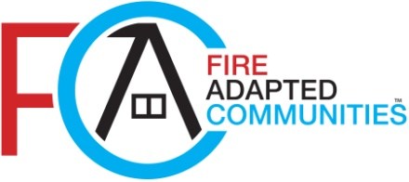
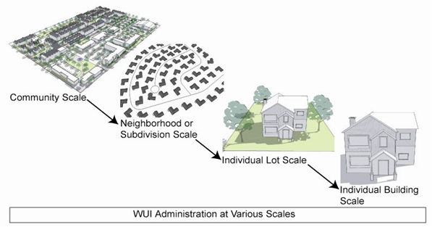
Addressing wildfire at all scales
FAQs about FAC
Firewise Home Ignition Zone Assessment
Fire Resistant Materials
CWPP
Firewise Community Assessment
Image credit: Clarion Associates, 2011

Slide 6
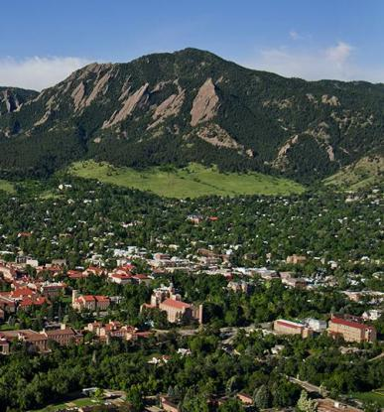
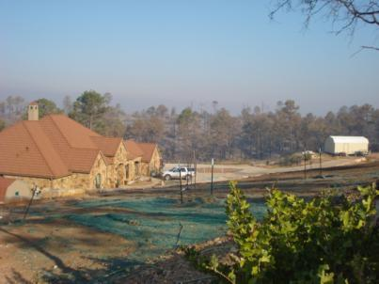
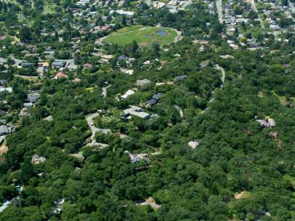
CWPP
Three Different Assessment Tools
Three Pieces of the Fire Prevention Puzzle
FIREWISE COMMUNITY ASSESSMENT
HOME IGNITION ZONE ASSESSMENT
>30m
Notes:
<number>

Slide 7
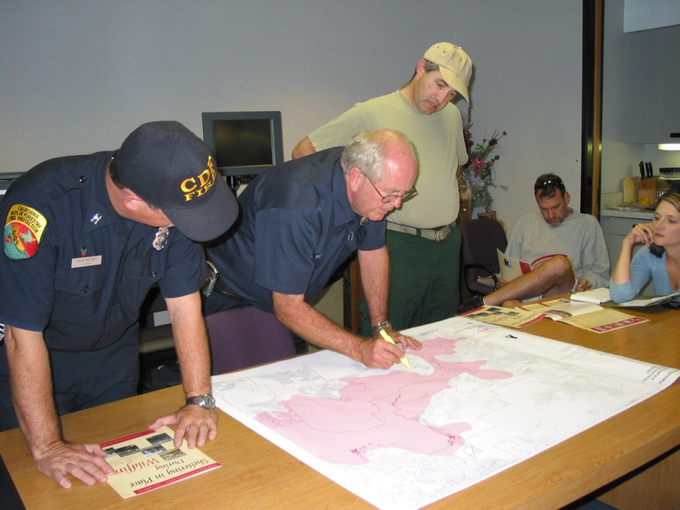
ASSESSMENTS ARE A FIRE MITIGATION TOOL
The Key Elements of Assessments:
Gathering Data
Evaluating the Information Gathered

Slide 8

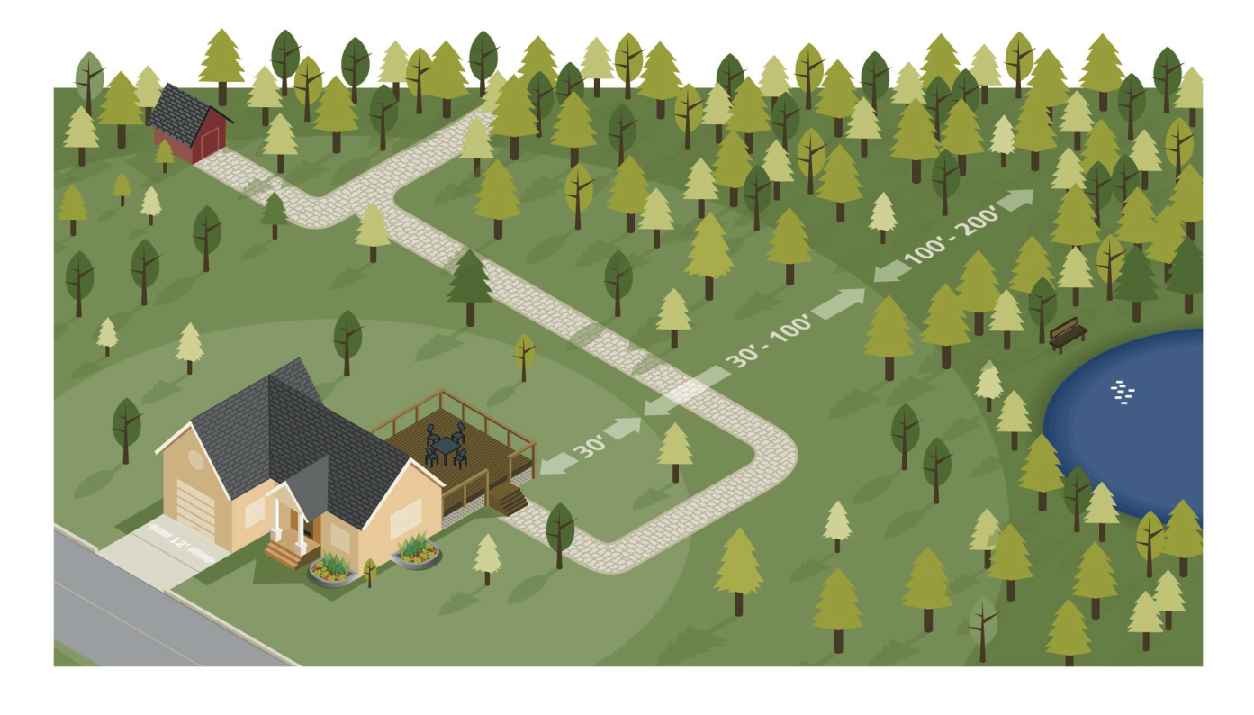
THE HOME IGNITION ZONE
The First Piece of The Fire Prevention Puzzle
This suggests we play a role in protecting our homes
We can modify our ‘home ignition zones’
Notes:
<number>
Here is a quick list of the topics we’re going to cover today.

Slide 9
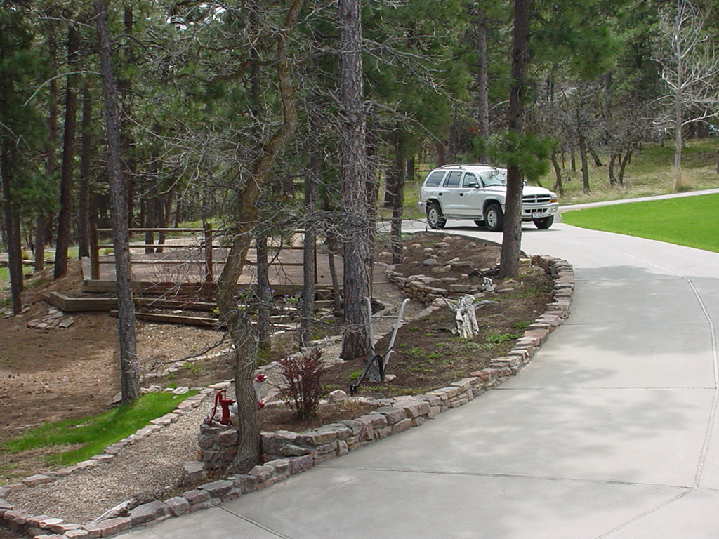
THE HOME IGNITION ZONE
A house burns because of its interrelationship with everything in its immediate surroundings (150-200 feet)
What happens within this zone is critical to structure survival
A wildfire’s potential relationship with a house can be interrupted here
Notes:
<number>
Firewise Communities plays a critical role in areas outside the jurisdiction of government entities: private land in thewildland/urban interface (WUI). Through its facilitation and information resources, the national Firewise Communities program has been a model of cooperation between federal, tribal, state, and local government; private industry; nonprofit organizations; and community groups. At the heart of the program is a focus on personal responsibility. Communities are encouraged to adopt a long-term, proactive approach to protect their homes and resources from the risk ofwildlandfire – before a fire starts.

Slide 10
The Home Ignition Zone
Notes:
<number>
Before we look at what we can do to reduce our hazards, let’s first consider what makes homes ignite.

Slide 11
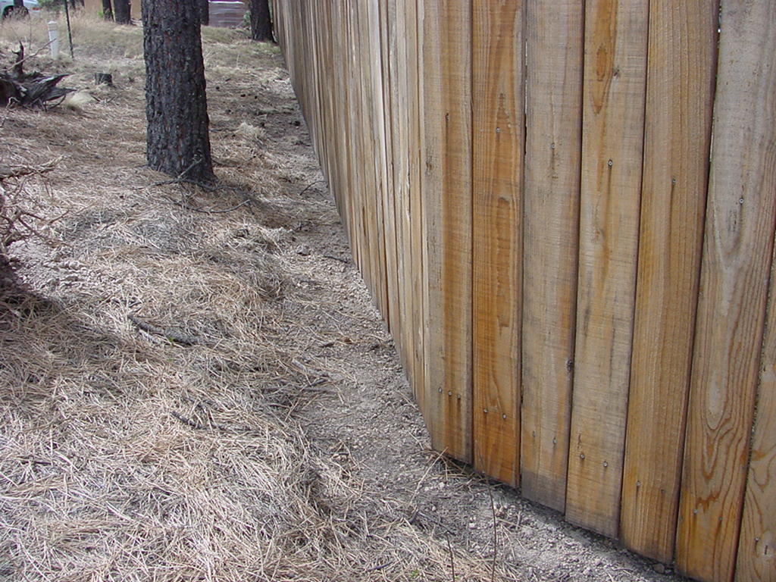
What else can we do?
Keep mulch and pine needles away from your house, fence and deck. If something is attached to the house, it is part of the house
Notes:
<number>

Slide 12
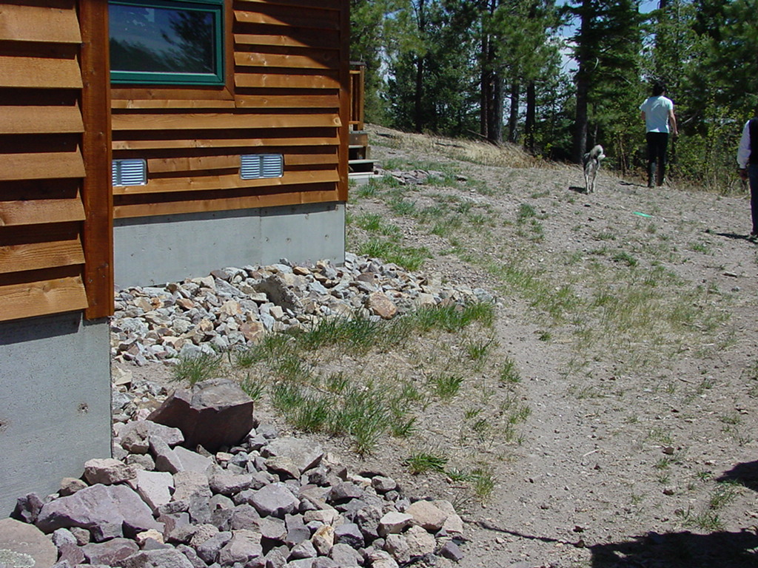
What else can we do?
Create a ‘fuel free’ area around your house that runs one yard out on all sides.
When preparing your home ignition zone, start with the house and work out
Notes:
<number>

Slide 13
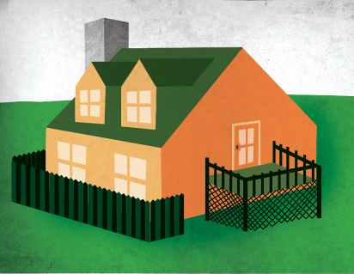
Look at Firewise construction in the
backyard
TheHome Ignition Zoneincludes
the home, in addition to its immediate surroundings up to 200 feet.
If it’s attached to the house, it’s part of the house.
Notes:
<number>
Let’s start with the home itself – the center of the home ignition zone 1.
Even if a landscape is designed in perfect compliance with Firewise recommendations, fire may still reach your home. Remember that heavy winds can carry firebrands over the tops of trees to land on a roof. If that were to happen to your home, your home’s exterior must play an important role in preventing ignitions that could lead to total home destruction. When considering improvements to reduce wildfire vulnerability, the key is to consider the home as part of the entire home ignition zone – the house itself and its immediate surroundings within 100 to 200 feet. The home’s vulnerability depends on how much flammable vegetation and other hazards are surrounding it, in relation to the vulnerability of the home’s construction materials. The higher the fire intensities within the home ignition zone, and the greater the firebrand exposure from the wildfire, the more you need non-flammable construction materials and a resistant building design.

Slide 14
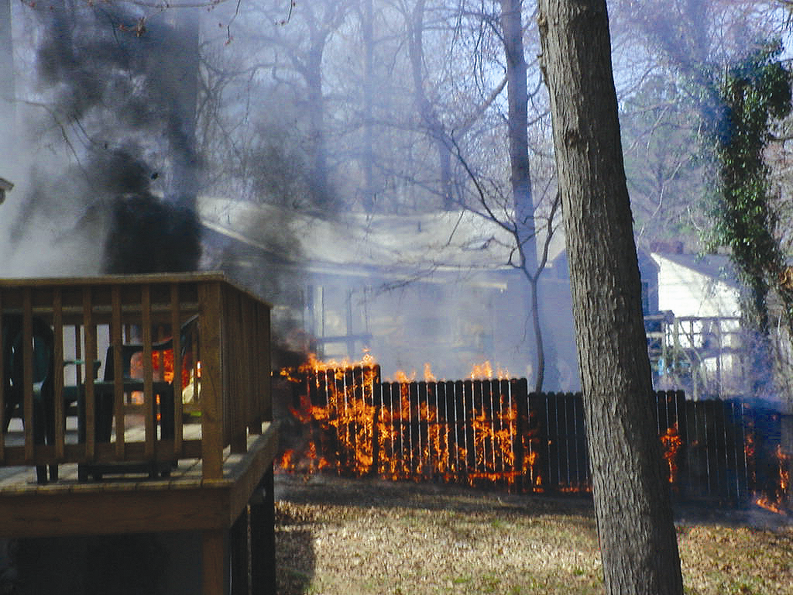
If it’s attached, it’s part of the house!
Notes:
<number>
Assessing Wildfire Hazards in the Home Ignition Zone
If it is attached to the house it is part of the house.

Slide 15
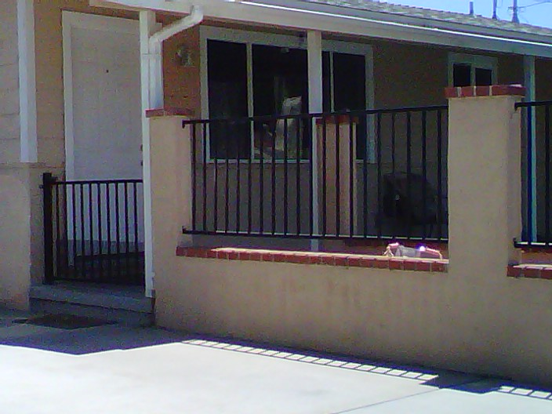
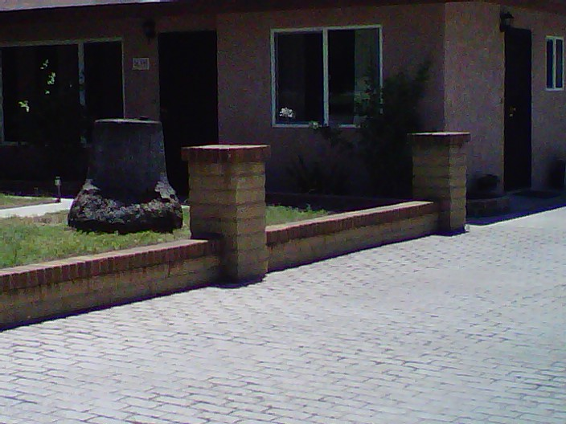
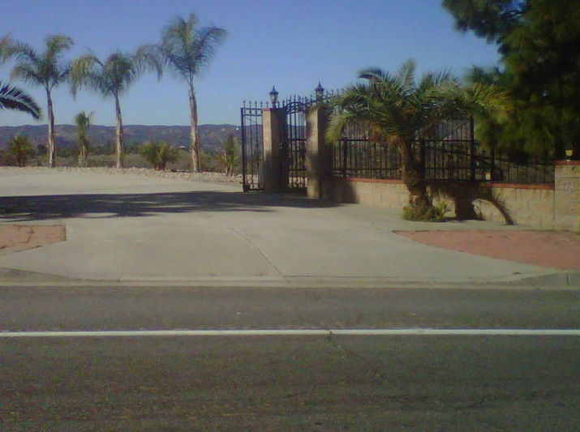
A Look at some Better Attachment Choices

Slide 16
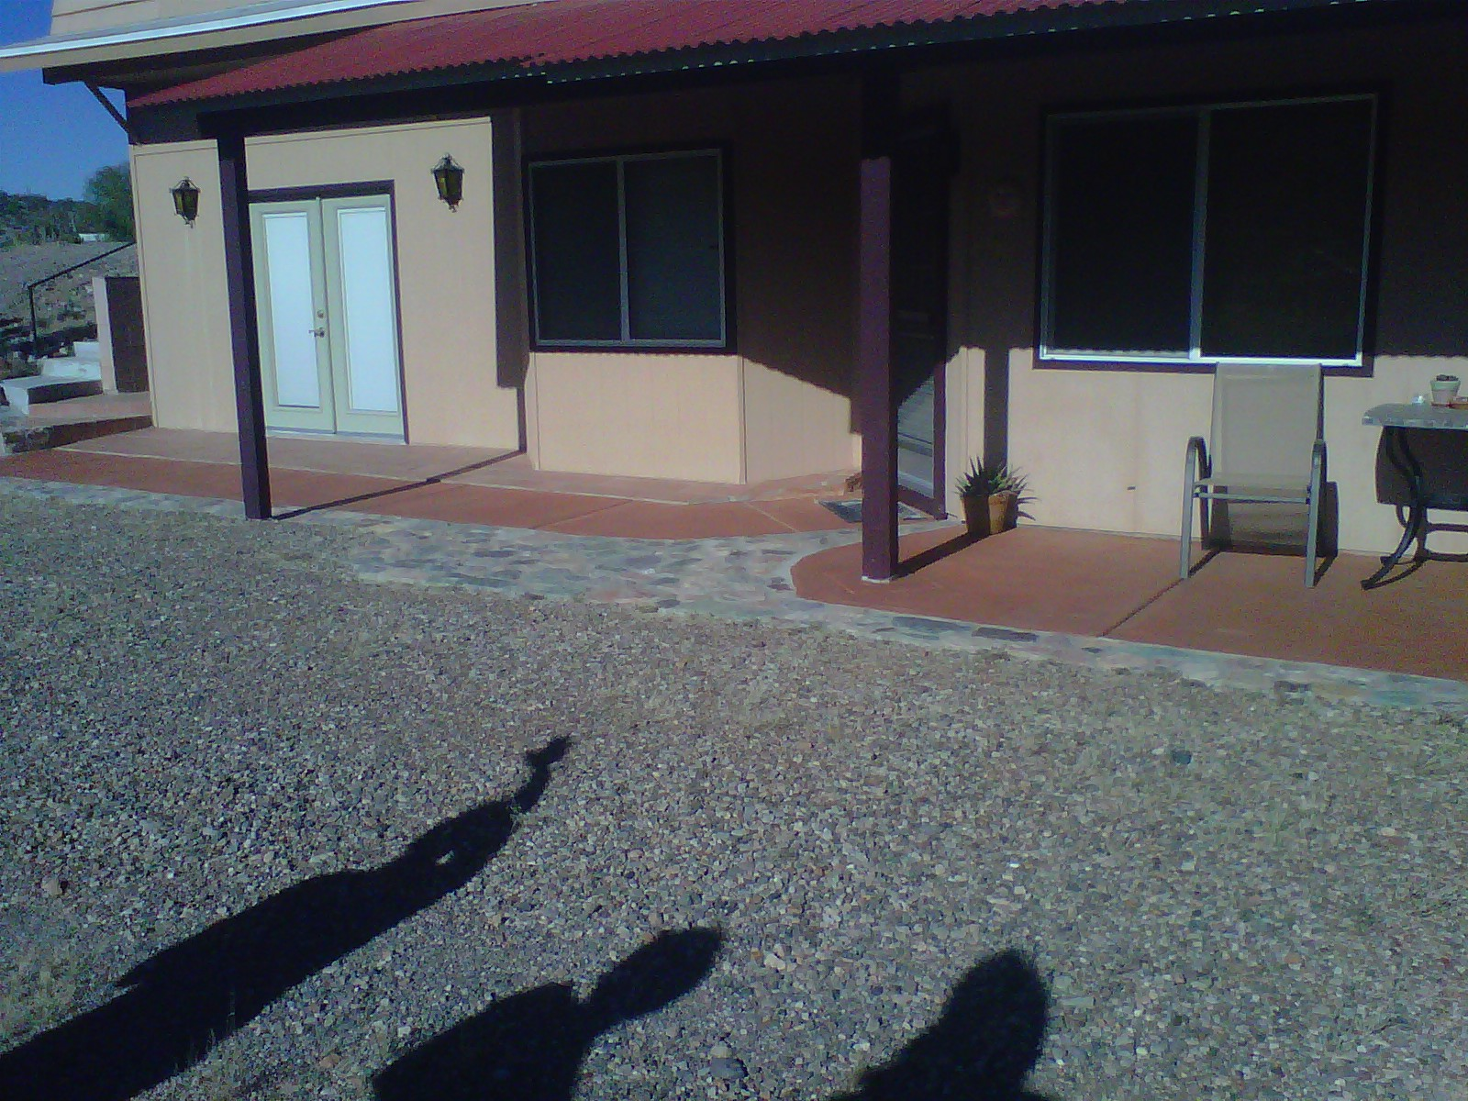
Home Hardening

Slide 17
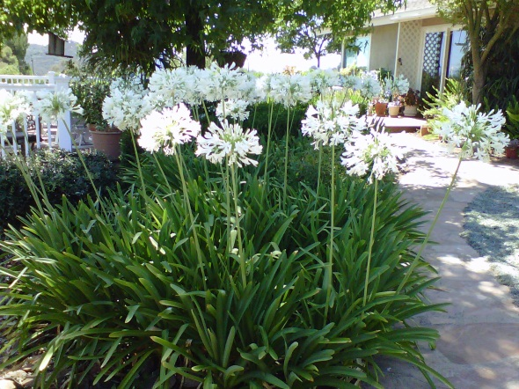
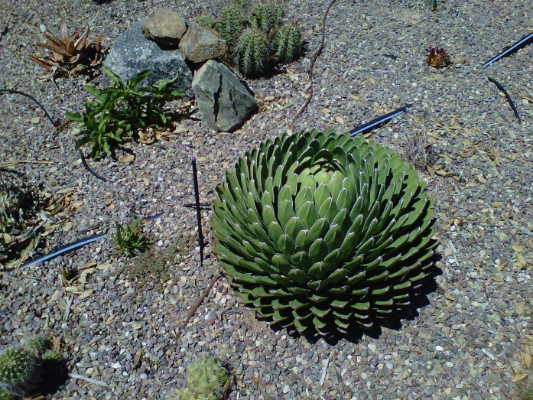
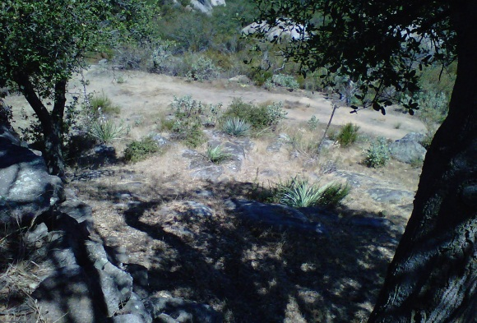
Plant Types to have Near your Home
Plants should be:
Low in Resins
High in Moisture
Low in Duff (shed materials such. leaves etc.)Low maintenance/water
High in salt or soapy plants such as Soap Worts
Good Plant Choices:

Slide 18
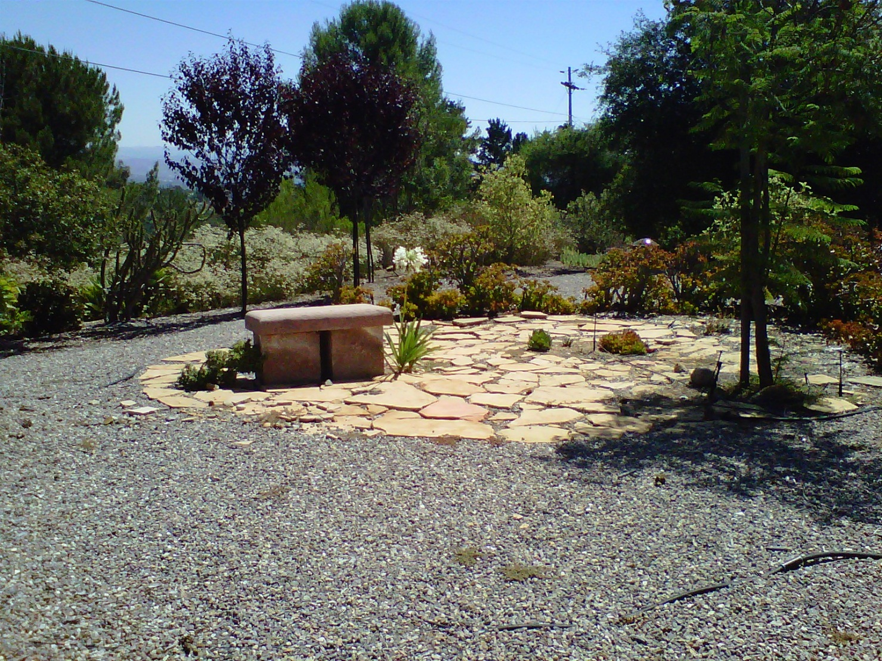
Firewise Landscaping

Slide 19
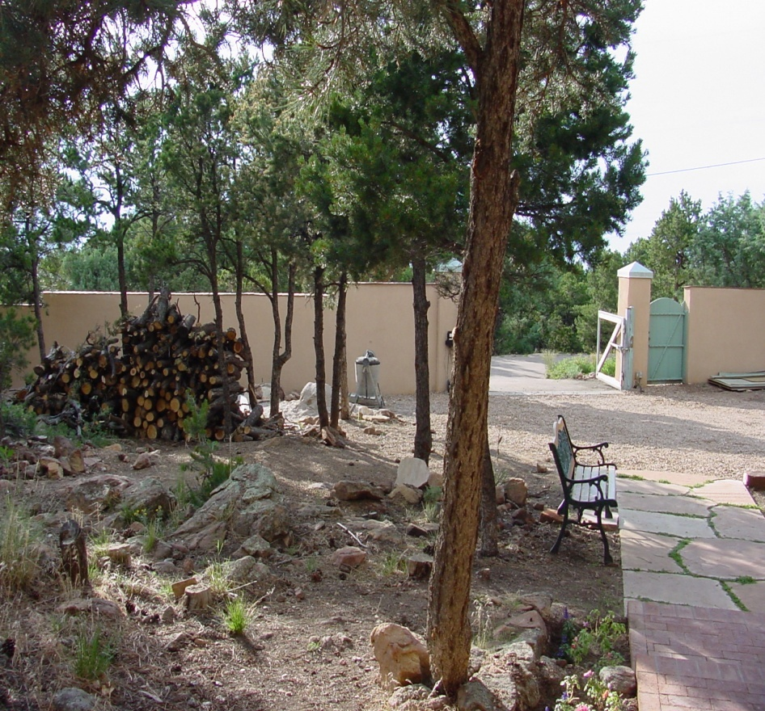
What else can we do?
During fire season, store fire wood at least 30 feet from your house
Notes:
<number>

Slide 20
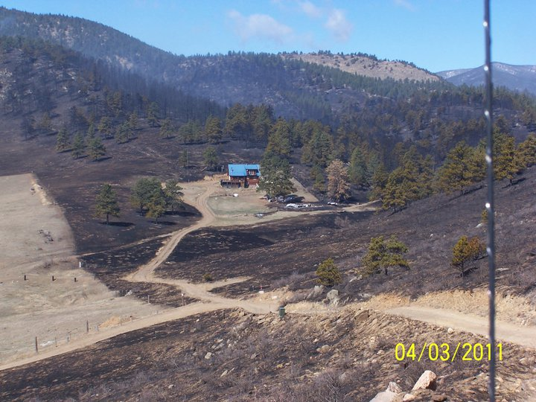
Wildfire Preparation = Big Win
In April 2011 the owners of this Colorado home evacuated
They returned to find their home intact; 13 surrounding homes destroyed
Notes:
<number>

Slide 21
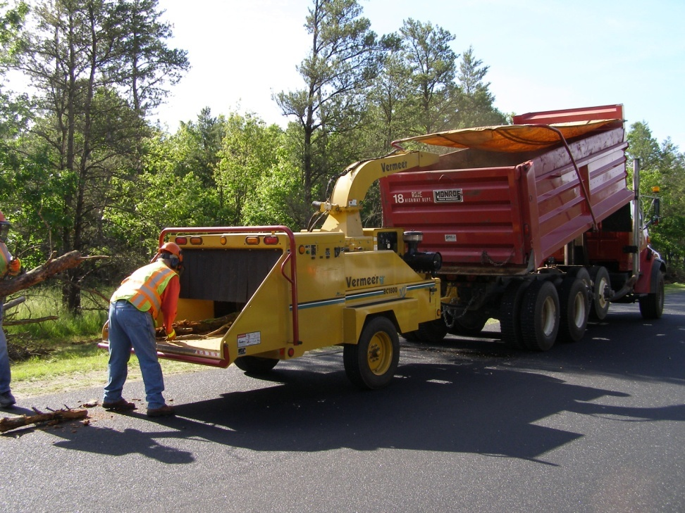
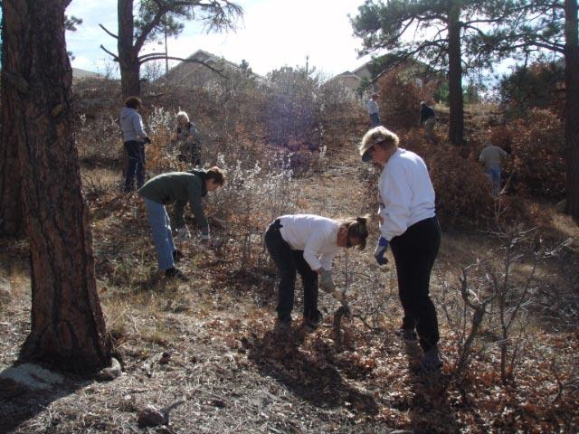
A LARGER IGNITION ZONE THE COMMUNITY ASSESSMENT
By changing the character of a home ignition zone, you may save a structure
By modifying acommunity’signition zone, you have the opportunity to alter a wildfire’s path for an entire community
This is where the Firewise program enters, beginning with a community assessment
Notes:
<number>

Slide 22
FIREWISE COMMUNITY ASSESSMENT
THE SECOND PIECE OF THE PUZZLE
The community assessment is the first step in the process of achieving Firewise Communities/USA recognition status
This important program component provides critical wildfire information to homeowners within a potential Firewise site
A specific format is not required, but the program endorses the following assessment style
Notes:
<number>
Wildfires are inevitable in fire-adapted ecosystems.
During large interface fires hundreds of structures an hour may be ignited.
No fire suppression system in the world can stop losses from these large conflagrations.

Slide 23
A LARGER IGNITION ZONE
By changing the character of a home ignition zone, you may save a structure
By modifying acommunity’signition zone, you have the opportunity to alter a wildfire’s path for an entire community
This is where the program enters, beginning with a community assessment
Notes:
<number>
Focus on mitigation/preventative actions that reduce lossesbefore the event.
Reduce potential fire intensity that the vegetation will influence.
Reduce the structure’s ignitibility.

Slide 24
COMMUNITY ASSESSMENT
The assessment should provide residents with an easy-to-understand document that:
  Familiarizes them with the way ignitions are likely to occur---and homes are likely to be lost---during a wildfire within the community
  Explains and illustrates common strengths and vulnerabilities with respect to wildfire risk

Slide 25
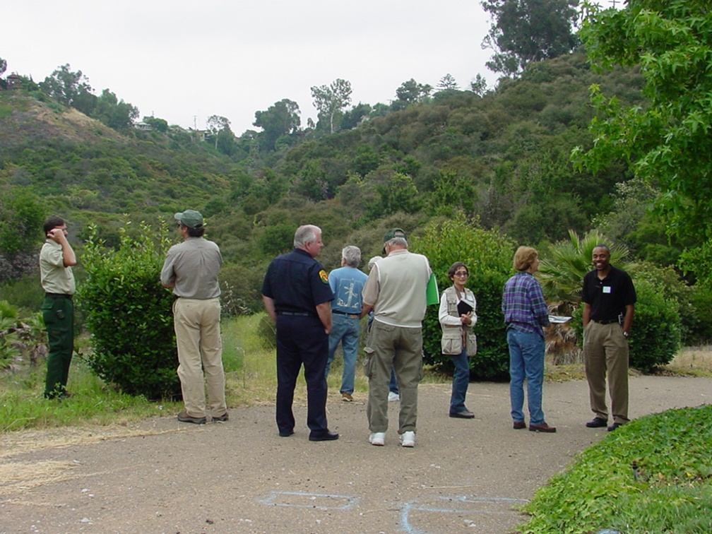
COMMUNITY ASSESSMENT COURTESIES
Announce when you will arrive and invite local participation
Include all interested jurisdictional fire staff
When taking photographs, do not include address numbers or other identifying features

Slide 26
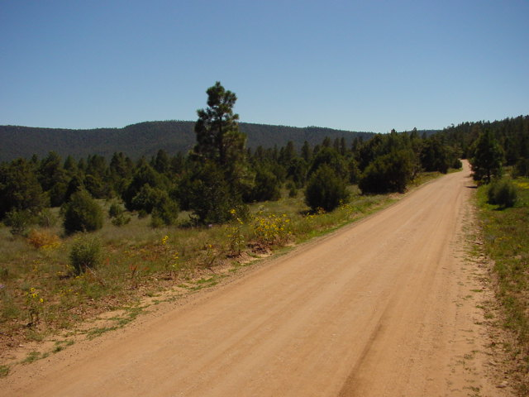
PREPARING THE ASSESSMENT
Writing the assessment requires an understanding of the community’s…
  Likely severe-casewildlandfire characteristics
  Geography
  Vegetation
  Social considerations
Do Your Homework Ahead o
Of the Assessment

Slide 27
SUGGESTED ASSESSMENT FORMAT
SEE TEMPLATE
Description of [Size and Nature of] the Severe CaseWildlandFire Characteristics that Could Threaten the Area.Use template text for first portion of section. The template can be found in “The User Reference Guide to Developing Firewise Communities”, found on thefirewisewebsite atwww.firewise.org
  Add description of the anticipated severe-case wildfire that is likely to threaten the area. It is important that homeowners understand “their fire’s” characteristics. They can then create an effective plan to modify its path

Slide 28
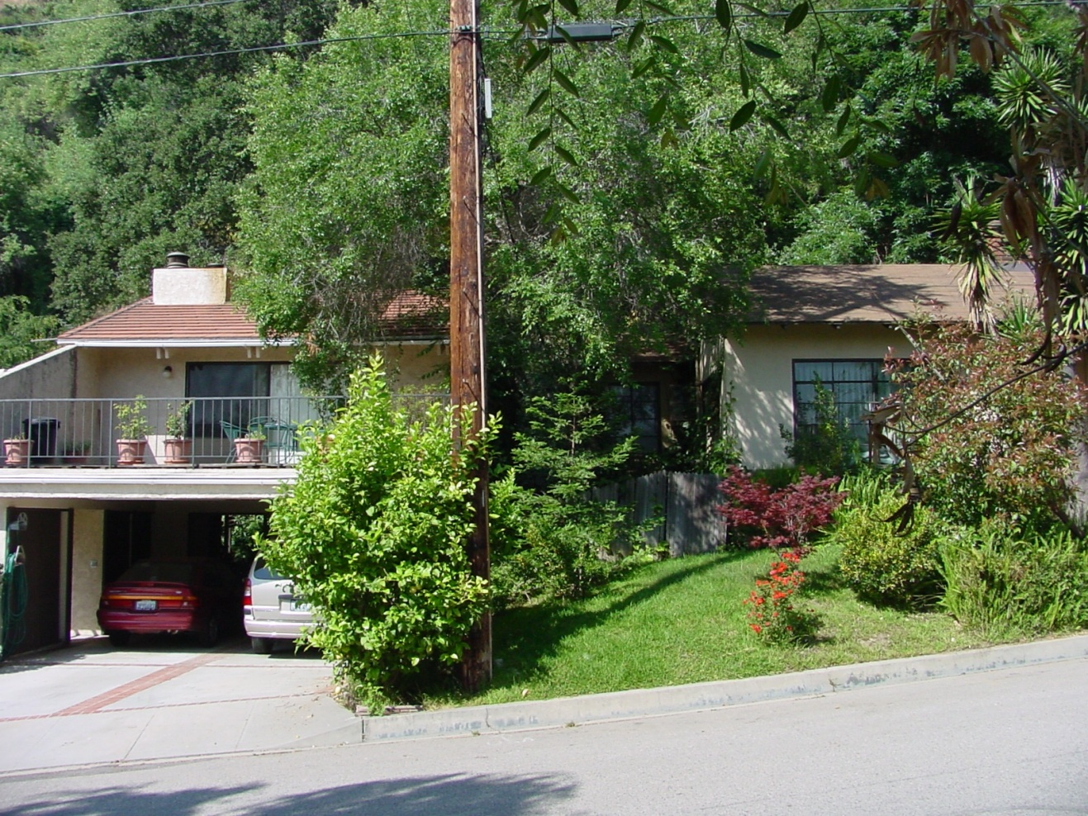
Look At the Neighborhood as a Whole
Work with our neighbors!
Where homes are close enough to ignite one another, neighbors must work together to modify overlapping home ignition zones
Notes:
<number>

Slide 29
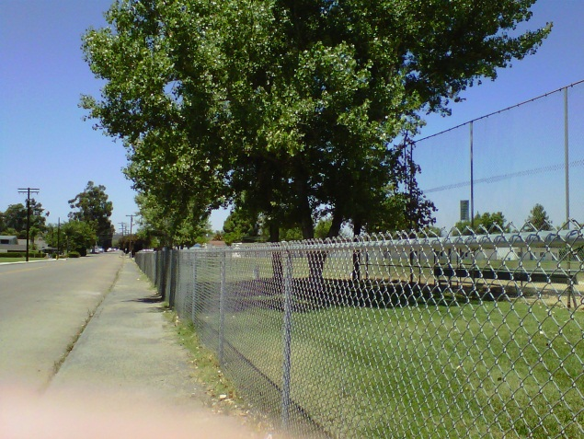
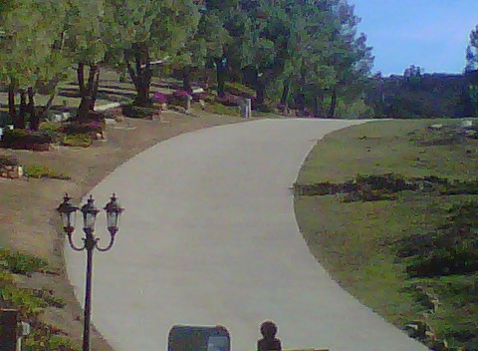
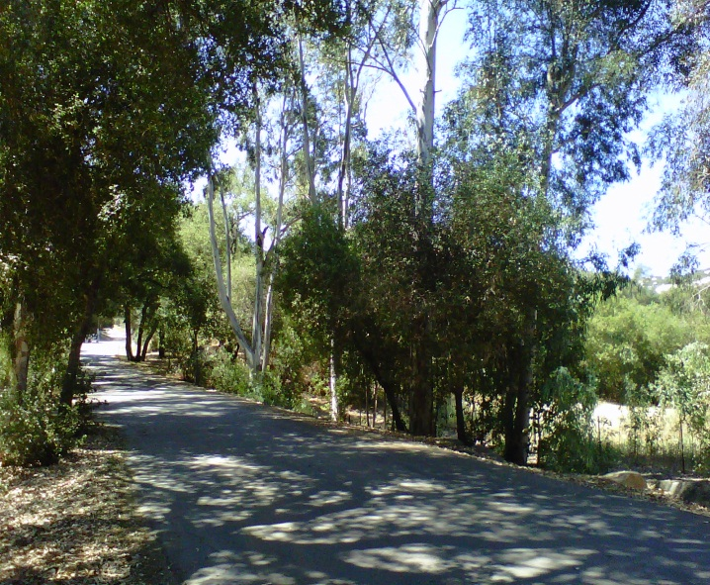
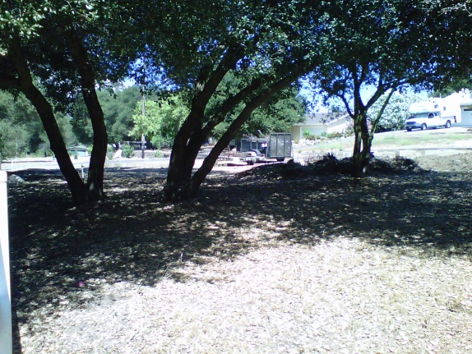
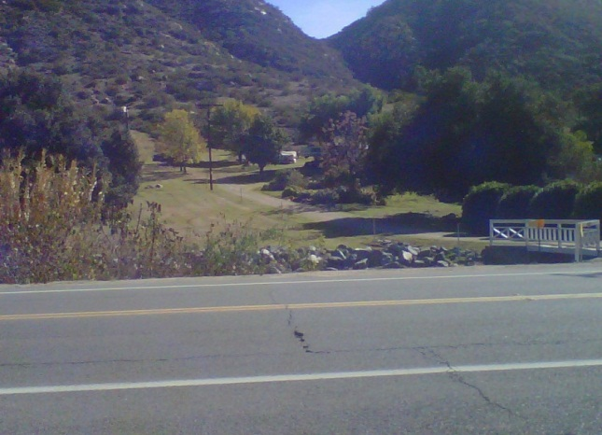
Work Together on Common Areas Such as Roads and Parks
Which roadway would you choose to take your fire truck in a wildfire event? This One:
Or one of these?

Slide 30
PRESENTING THE COMMUNITY ASSESSMENT
Bring it to the Firewise Board
Be sure Board members understand the home ignition zone and the ability the community has to modify its risk there
Explain the assessment and its findings. Direct the Board to create an action plan of workable, agreed-upon mitigation solutions

Slide 31
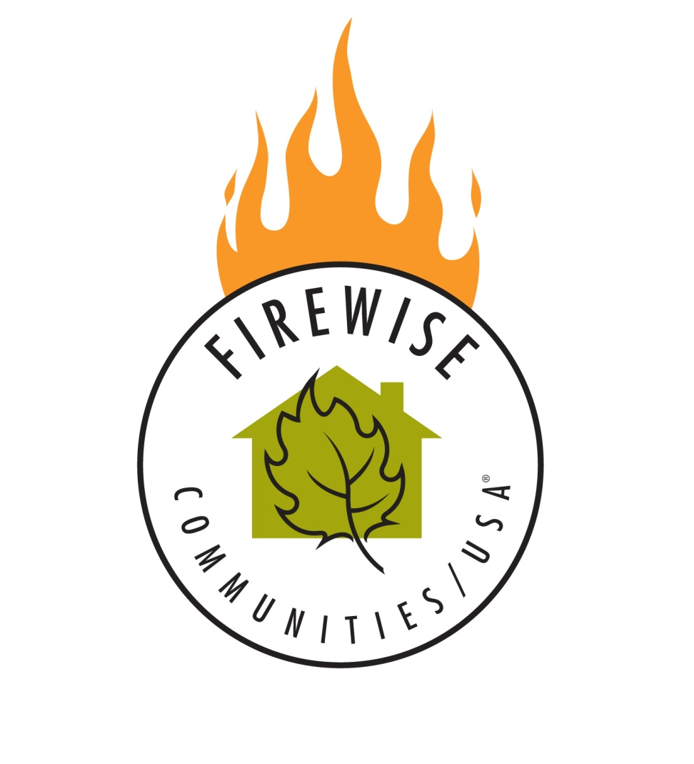
THE PROGRAM WORKS!
Over a period of years, visible change occurs within participating communities
Homeowners find the process easy to understand and implement

Slide 32
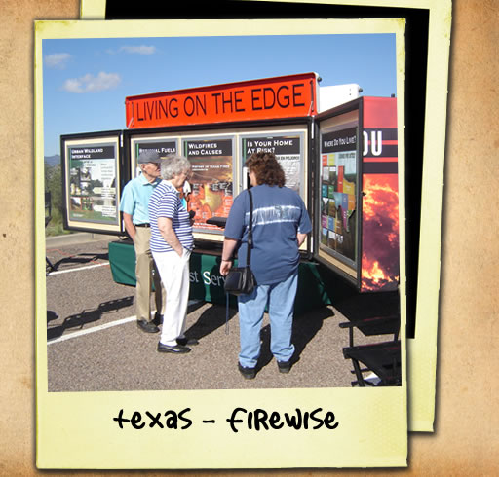
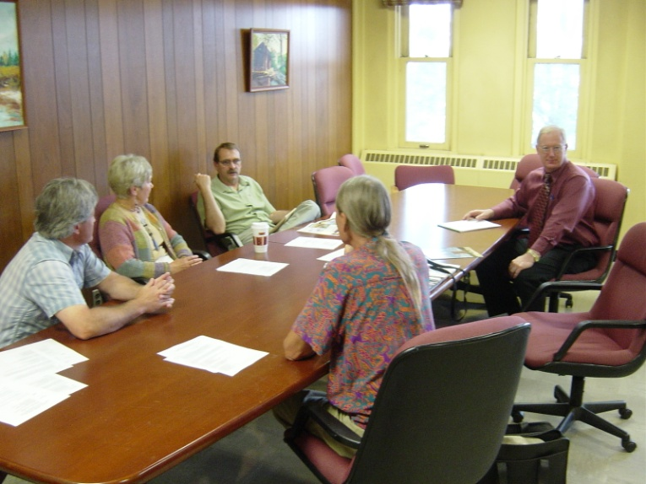
The Firewise Approach: Community Wildfire Protection Plan (CWPP)
It incorporates the efforts of individual homeowners, local communities, local fire jurisdictions, federal and state agencies and tribes.
This is the Third Piece of the puzzle
Notes:
<number>

Slide 33
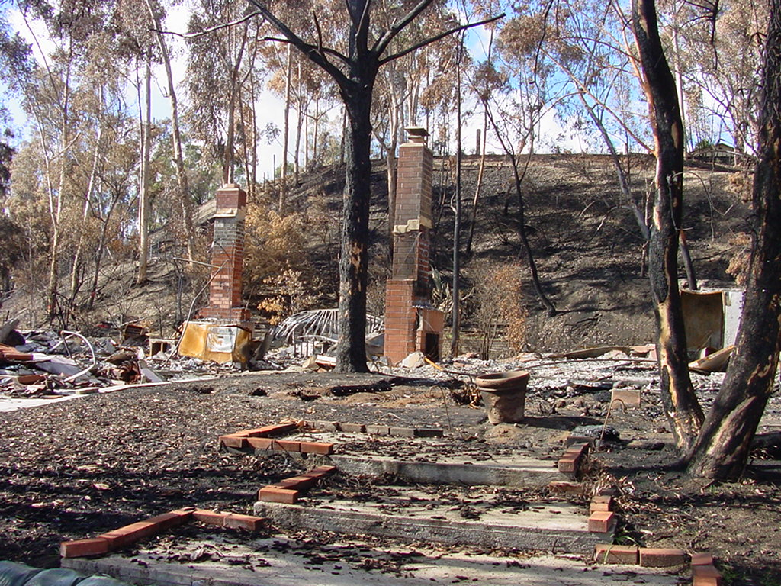
CWWPs are Authorized and Defined in Title 1 of the Healthy Forest Restoration Act of 2003
CWPP’s are wildfire mitigation plans for much larger geographical areas and are collaboratively developed.They can be as simple or complex as the community desires. The basic components of a CWPP are:
  Collaboration
  Prioritized Fuel Reduction
  Treatment of Structural Ignightability

Slide 34
Collaboration
A CWPP must be collaboratively developed by local, tribal and state government representatives in consultation with federal agencies and other interested parties. It is important to invite all interested stakeholders. Track meetings and participants. In the template that I have provided there is a table to track meetings and collaborators

Slide 35
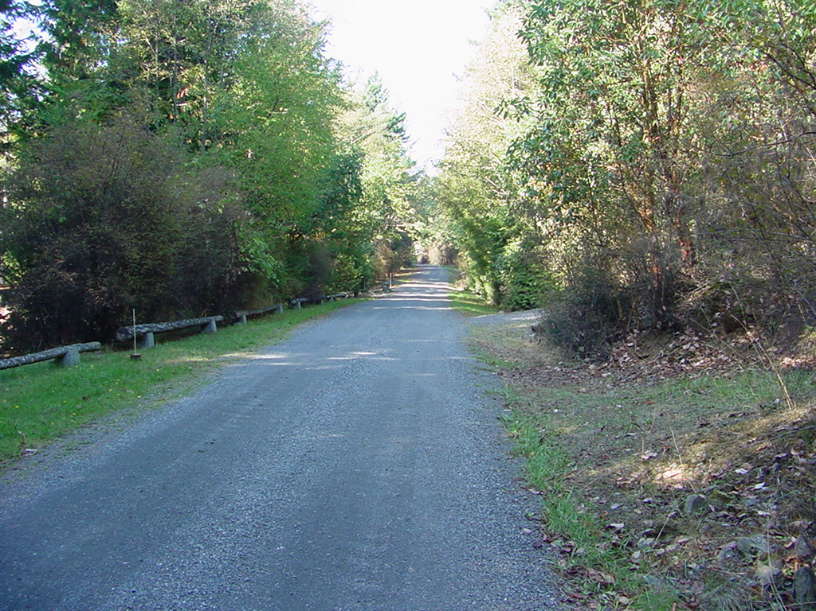
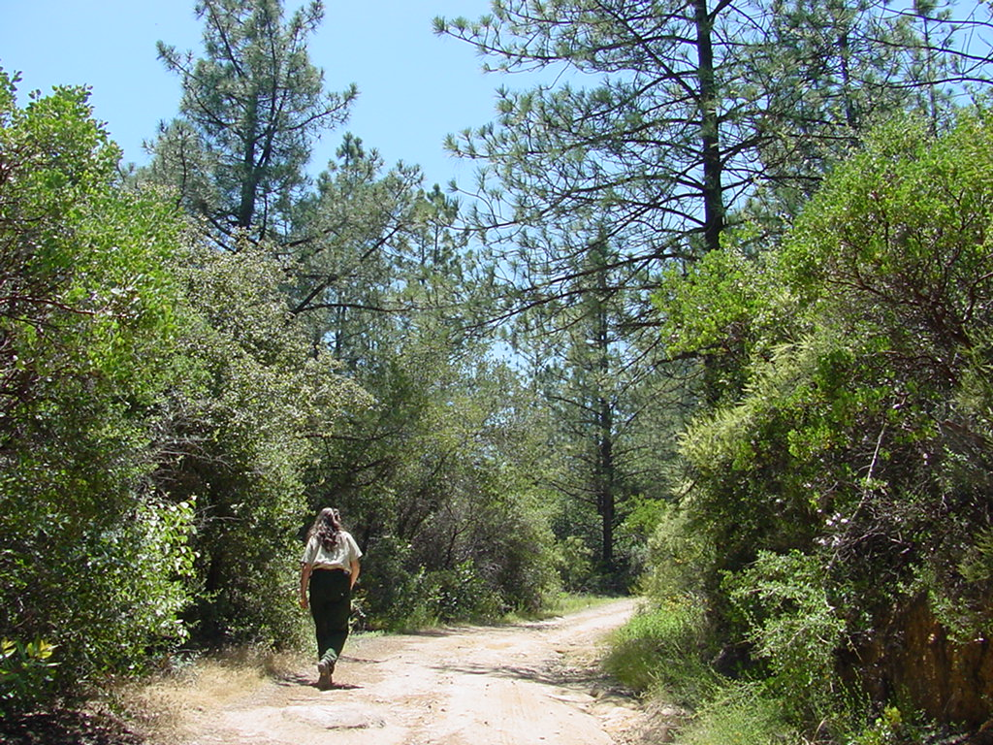
Prioritized Fuel Reduction
A CWPP must identify and prioritize areas for hazardous fuel reduction treatments on federal and non-federal land and recommend the types and methods of treatment that will protest one or more community at risk and other assets at risk including schools, hospitals and businesses.

Slide 36
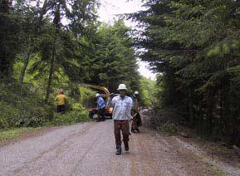
Suggested Fuels Reduction Projects
Fuels treatments along roadways
Community chipping/cleanup days
Assistance programs for neighbors unable to completefirewisemaintenance of vegetation and other fuels found in their home ignition zone
Fuels treatments in common areas such as local parks and other shared ignition zones

Slide 37
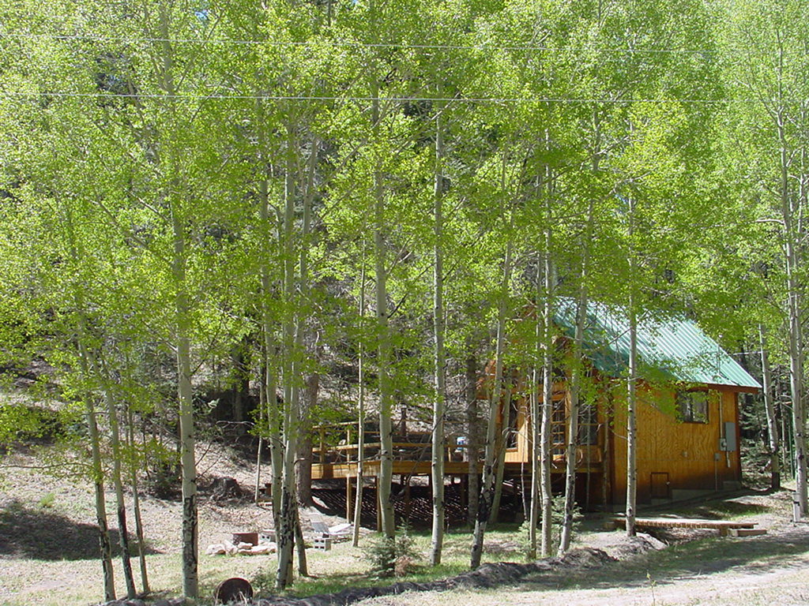
What else can we do?
In wooded areas, thin trees, removing down and dead and the ladder fuels. Firewise choices include healthy, large specimens and deciduous species, when present
Notes:
<number>

Slide 38
Suggestion of Mapping Tools to Be Used to Complete this Assessment
Area Map:which shows an overview of your community
Assets At Risk Map:shows inhabited areas and values that are threatened by wildfire
Communities Map:shows population centers
Topographic Map:that shows valleys, canyons etc.
Fire Threat Map:shows expected fire frequency and potential fire behavior
Fire History Map:shows the fire history of your area
WUI Zone Map:shows preliminary designation of your community’s federally identified wild-land urban interface
Vegetation Map:shows the vegetation classes within and adjacent to your community.

Slide 39
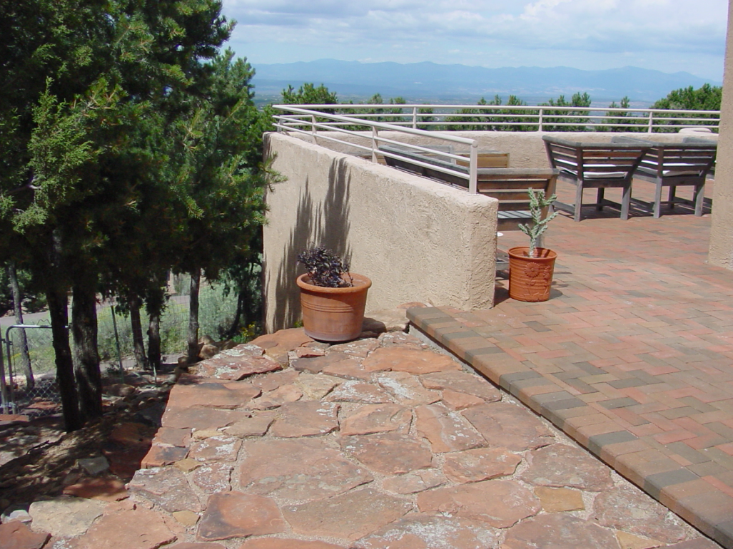
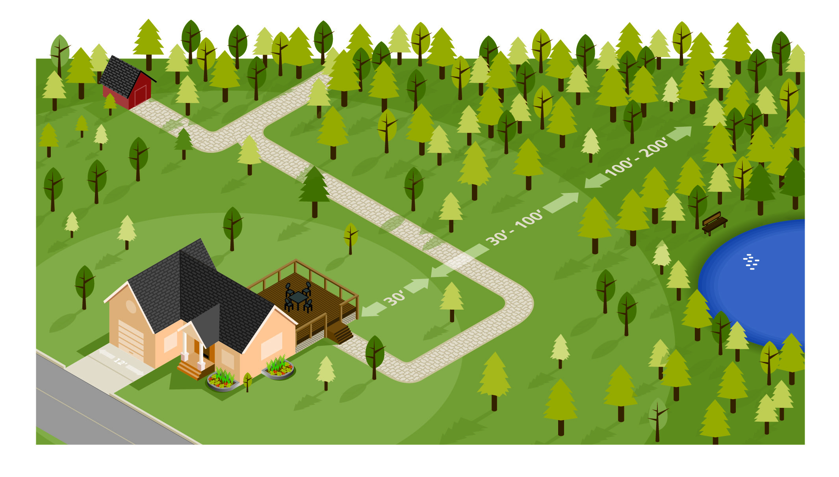
Treatment of Structural Ignightability
A CWPP must recommend measures that homeowners and communities take to reduce the ignightability of structures throughout the area addressed by the plan.

Slide 40
Look at Firewise Construction
Look at the homes in the area and identify broad scale trends that appear to be reoccurring, such as wood shake roofs, attachments such as decks and porches etc.
If it’s attached to the house, it’s part of the house.
Notes:
<number>
Let’s start with the home itself – the center of the home ignition zone 1.
Even if a landscape is designed in perfect compliance with Firewise recommendations, fire may still reach your home. Remember that heavy winds can carry firebrands over the tops of trees to land on a roof. If that were to happen to your home, your home’s exterior must play an important role in preventing ignitions that could lead to total home destruction. When considering improvements to reduce wildfire vulnerability, the key is to consider the home as part of the entire home ignition zone – the house itself and its immediate surroundings within 100 to 200 feet. The home’s vulnerability depends on how much flammable vegetation and other hazards are surrounding it, in relation to the vulnerability of the home’s construction materials. The higher the fire intensities within the home ignition zone, and the greater the firebrand exposure from the wildfire, the more you need non-flammable construction materials and a resistant building design.

Slide 41
If it’s attached, it’s part of the house!
Notes:
<number>
Assessing Wildfire Hazards in the Home Ignition Zone
If it is attached to the house it is part of the house.

Slide 42
Structural Ignightability
What home improvements or modifications can be made to local structures to reduce theirignightability? Some good reference materials include:
NFPA 1144 Standard for Reducing Structure Ignition Hazards fromWildlandFire 2008 Edition
Firewise Principals
Local and state building and fire codes
Firewise booklet A New Look at Understanding Hazard Assessment Methodologieswww.firewise.org
Lists of state approved fire resistant building materials
IBHS website
Notes:
<number>

Slide 43
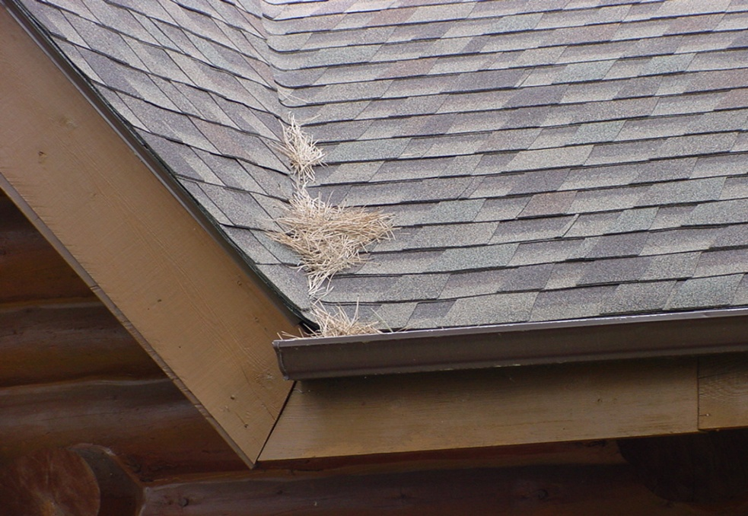
What else can we do?
Pine needles are unwelcome in your gutters or on your roof
Notes:
<number>

Slide 44
Firewise Recommends…
Rated roofs (A, B or C)
  Levels refer to the size of a burning firebrand placed on the roof assembly
Fire-resistant building materials
Fire-resistant plant materials
Notes:
<number>

Slide 45
Signature Page
Use a signature page that fits your community.
The HFRA requires that the three entities must agree to the final content of a CWPP:
The applicable local governments (i.e. counties or cities depending upon the areas included in the CWPP
The local fire departments
Tribal Authorities
The state entity responsible for forest management.

Slide 46
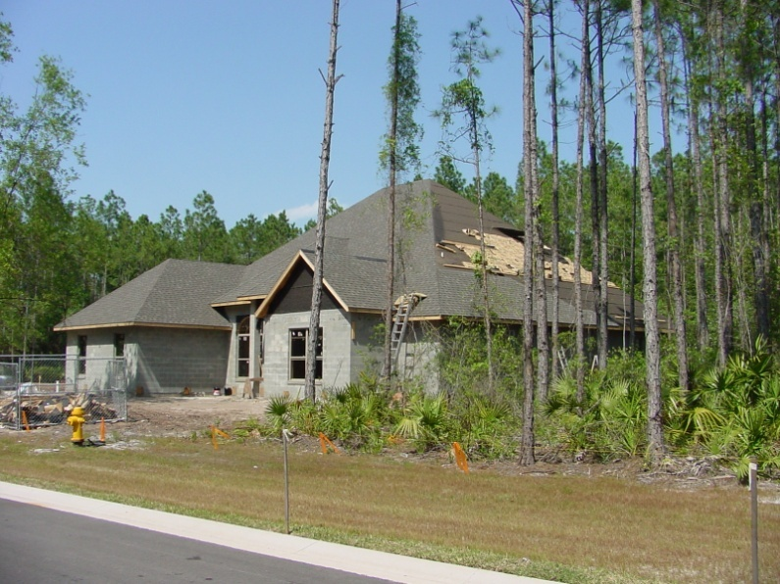
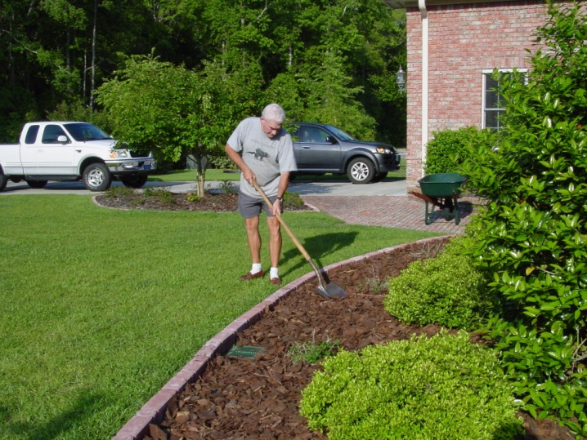
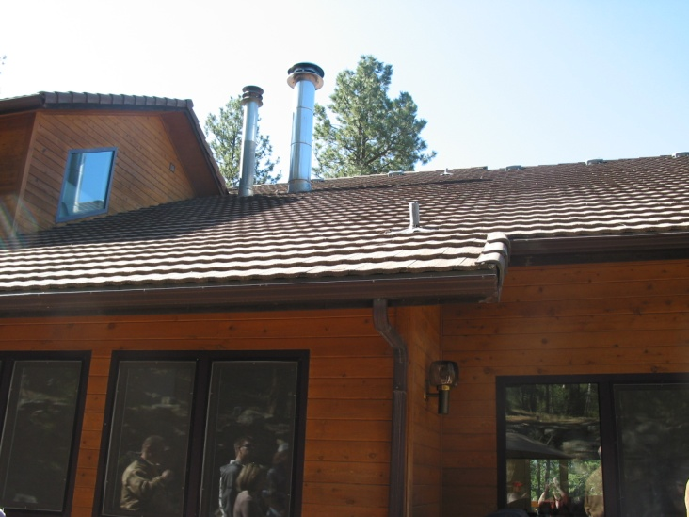
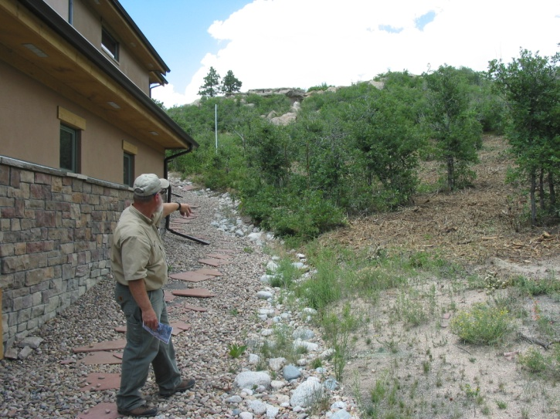
The Firewise Approach
A Firewise approach involves landscaping, home construction and design, and community planning, along with forest and land management.
Notes:
<number>

Slide 47
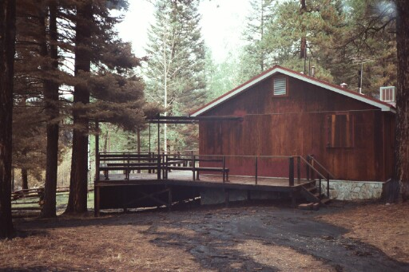
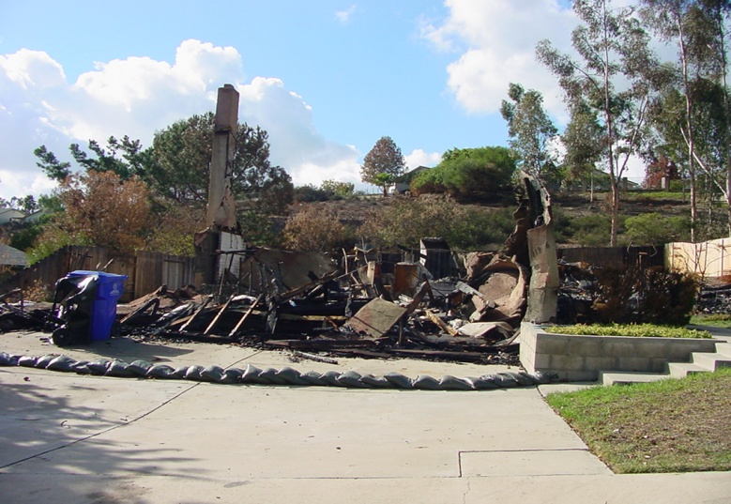

With an Effective Assessment The Community and HomeownerCan Create a Plan That Makes a Difference!
New Mexico
San Diego, California - 2003
Proper Planning and Action Makes a Difference
Notes:
<number>

Slide 48
Questions? Discussion?
Thank You!
Faith Berry
509 939-3251
firewisefaith@nfpa.org

