Slide 1
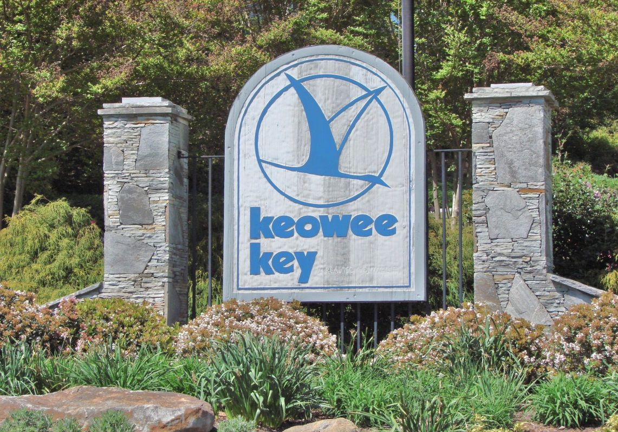
Creating, Building & Sustaining a Successful Firewise®Community Program
Presenters:
Richard Hiss – Keowee Key Firewise®Chair
Michael Bozzo – Past SC Firewise®Coordinator
Keowee Key, South Carolina
Notes:
<number>

Slide 2
Key Elements to: Create, Build, & Sustain a Successful Firewise®Community Program
Phase One –Creating and Building an Action Oriented Local Program
Phase Two –Sustaining the Program via Follow on Action Programs
Keowee Key, South Carolina
Notes:
<number>
The key elements to Create, Build, and Sustain a Successful Firewise Community we have found can be broken into two phases:
PHASE I: Involves the steps in creating and building a successful community Firewise program. and
PHASE II: consists of sustaining the community Firewise program.

Slide 3
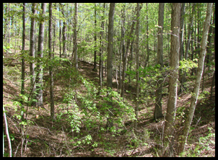
Phase One
Key elements:
Firewise Awareness
Initiating Action
Collaboration
Start Up
Motivation
Organization
Follow Through➔
Keowee Key, South Carolina
Notes:
<number>
Lets first talk about PHASE I: The key elements or steps to creating and building a successful community Firewise program are: Community Awareness, Conducting an Assessment, Initiating Action, Program Start Up, Motivation, Organization, Action and Follow through.

Slide 4
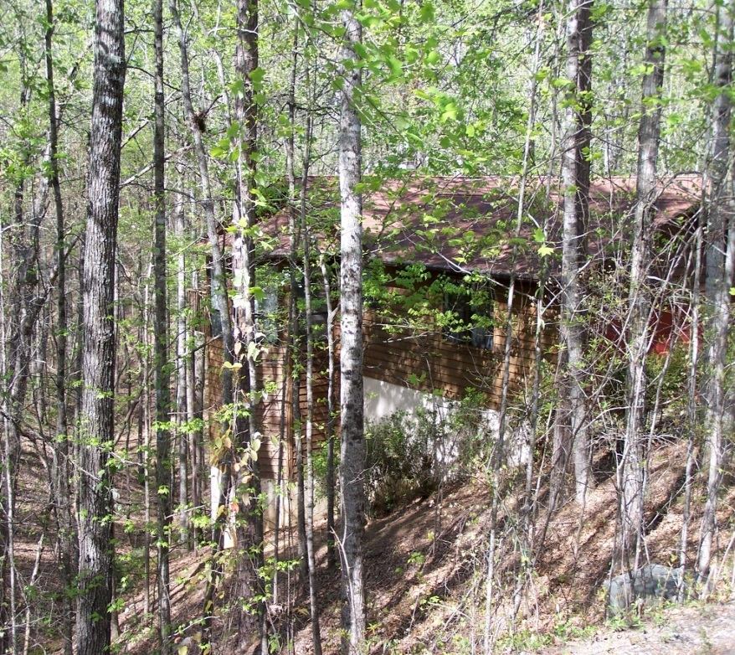
Wildfire Danger Awareness
Community developed within the WUI
Residents unaware of potential wildfire hazards
Steep terrain
Heavily wooded
Keowee Key, South Carolina
Notes:
<number>
AWARENESS: Too many homeowners, new to a woodland/urban community, don’t understand the potential wild fire dangers they face, nor the threat to their own home and total community infrastructure.
This was the situation for Keowee Key, an established private residential community in upstate S. Carolina in the Fall of 2004. Fortunately, some residents did understand the fire danger to their homes from internal causes, such as faulty fire places and electrical wiring, cooking stoves left unattended, and the occasional lightning strikes that nature delivers. This foresight, early in the development’s timeline, supported the establishment of a private fire company and station in the community, funded by resident financial assessments. However, the Firewise Community concept awareness did not yet exist.

Slide 5
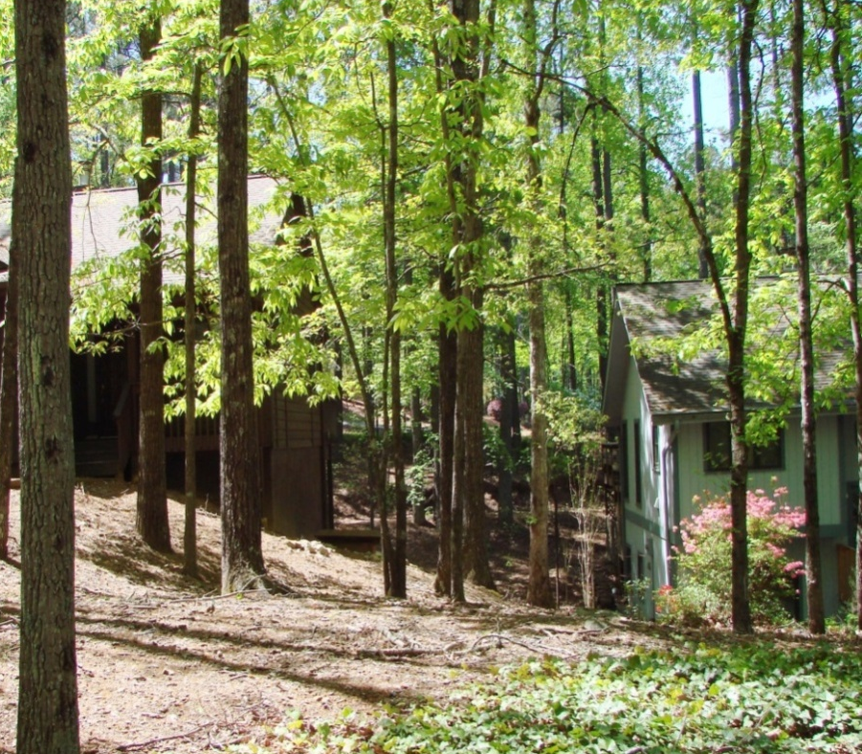
Assessment – Identified Issues
Community infrastructure
Hazardous fuel build ups
Emergency Access concerns
Homeowner
Lack of defensible space
Flammable landscape vegetation
Wake up call
Keowee Key, South Carolina
Notes:
<number>
The S. Carolina Forestry Commission was asked to perform a total Keowee Key community wildfire risk assessment of our fire preparedness, deficiencies and suggest near term action steps to address our status. They identified homes and community buildings exposed to flammable vegetation, significant private and community owned land, covered with underbrush of all types and dead and dying trees, both standing and partially fallen, throughout the 1,600 acres of the community. Their assessment was a real wake up call to action. Too many residents were totally unaware of the near term potential and consequences of a devastating ground fire in our current state of development.

Slide 6
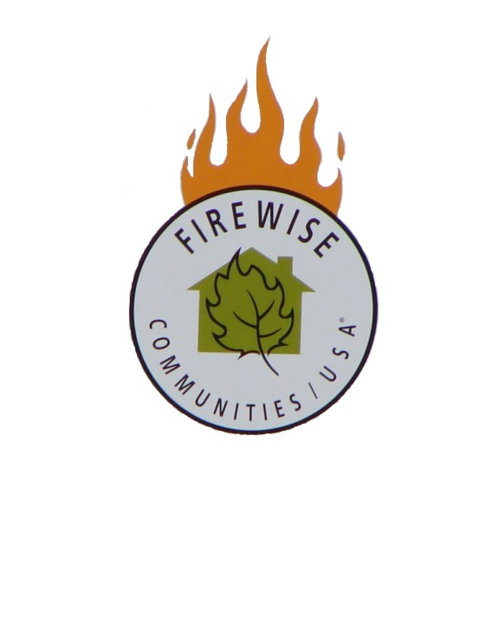
Initiating Action
Keowee Key Fire Dept. Firewise presentation
Board initiated Firewise®Community/USA status
Keowee Key, South Carolina
Notes:
<number>
INITIATING FIREWISE COMMUNITY ACTION: Keowee Key Fire Chief Mark Lee, in October 2005, presented to the community Board of Directors, the concept and program of becoming a Firewise Community. Based on his compelling presentation and the information from the SCFC assessment, the Board encouraged the formation of a Firewise Committee to evaluate, understand and act upon those steps required to becoming Firewise, both for individual residents and the total community. Expert knowledge of woodland/urban fire dangers was fundamental to launching this effort. Well intentioned, but underinformed residents simply would not have provided sufficient motivation to energize action for this undertaking.

Slide 7
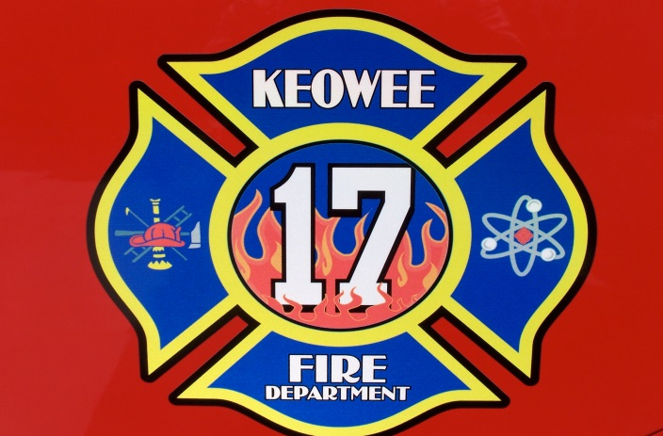
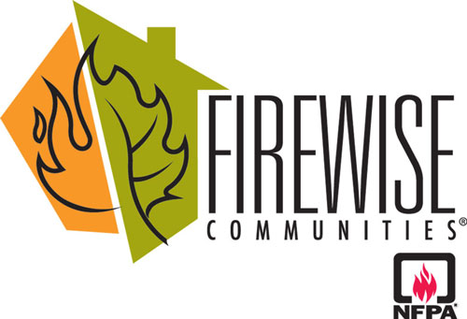
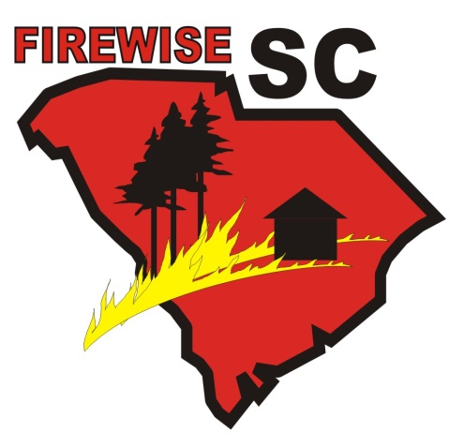
Collaboration
Keowee Key, South Carolina
Notes:
<number>
COLLABORATION AMONG THE KEWOEE KEY COMMUNITY, KEOWEE FIRE DISTRICT, SOUTH CAROLINA FORESTRY COMMISSION AND THE NATIONAL FIRE PROTECTON ASSOCIATION HAVE BEEN CRUCIAL TO THE ONGOING FIREWISE EFFORTS WITHIN KEOWEE KEY AND SURROUNDING COMMUNITIES

Slide 8
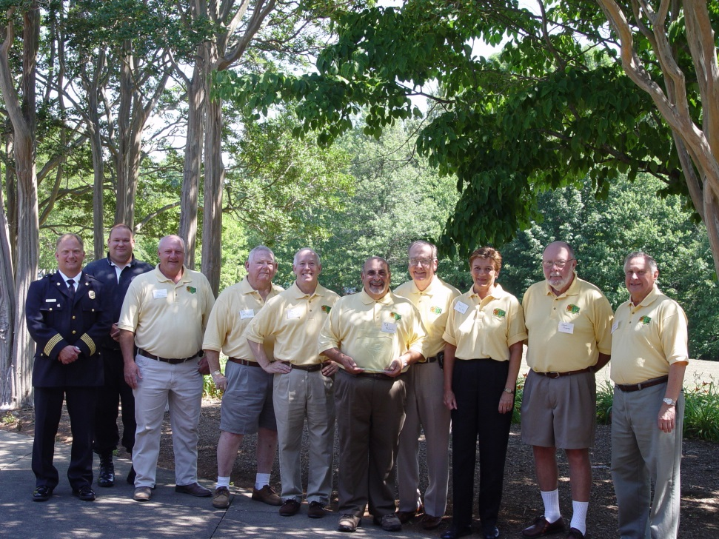
Start Up
Firewise®Committee formed
Keowee Key firemen,FireChief, residents
Education, Communication, Awareness
Keowee Key, South Carolina
Notes:
<number>
START UP – The initial Firewise Committee, was comprised of Keowee Key volunteer firemen, motivated/concerned residents and the Fire Chief. In early 2006 the Committee began the process of education about woodland fires and the consequences of being unprepared for their eventual occurrence. The emphasis was not to become fire fighters, but knowledge experts and communicators of what could be done near term, to raise awareness and initiate action.

Slide 9
Motivation to Become a Firewise Community
Coordinated action by State and local Fire personnel
Local Residents Committed to change
Education re: issues and dangers
Knowledge – “It could happen here.”
Keowee Key, South Carolina
Notes:
MOTIVATION - to become a Firewise Community:
We believe that successful motivation to becoming a Firewise Community and undertaking the actions steps to educate residents to act, is a combination of State and local fire experts, plus motivated community residents who are committed to making the recommended changes. Educational materials of all types were provided by the SCFC and our local Fire Chief. An excellent community Forum, organized and run by the local Committee, was well attended by concerned residents who had been exposed to this material and wanted to act. Graphic pictures of local house and woodland fires brought the danger message home quickly. The SCFC presenters explained that forest fires were not just a western U. S. experience, in fact, more wildfires occur east of the Mississippi River than west, and do happen in the South Eastern states as well.
<number>

Slide 10
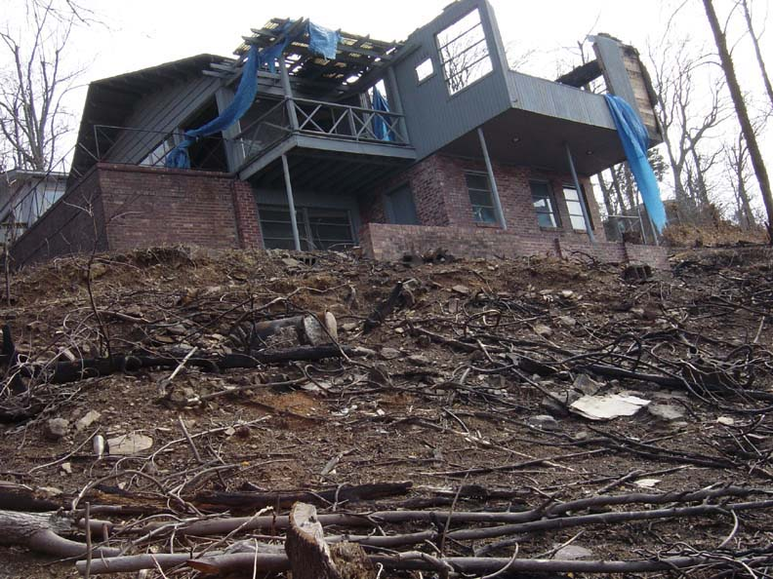
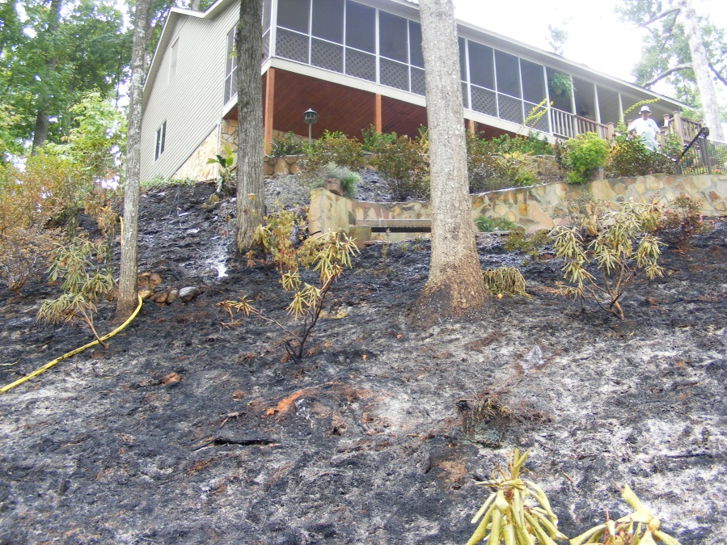
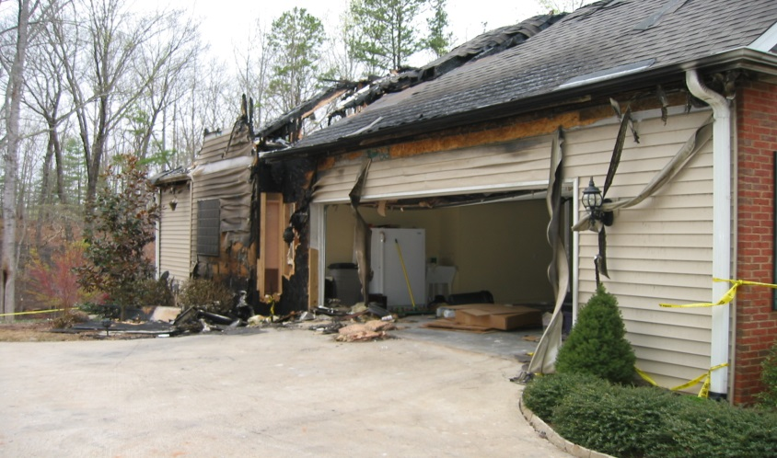
In our backyard…
Keowee Key, South Carolina
Notes:
<number>
It could happen here was clearly demonstrated. Examples of homes in the County, destroyed by their owner’s lack of knowledge, such as burning underbrush near their homes and not adequately extinguishing the embers, burning brush in metal barrels and generating a stream of flying embers, not paying attention to the slope of their yard and what they were doing as they tried to rid their yards of unsightly brush; all provided extremely dramatic motivation to wake up complacent owners and build support for a total community wide Firewise campaign.

Slide 11
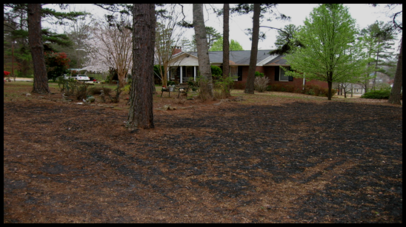
Organization
Firewise®Committee
Action Plan
Prioritized tasks
Education
Awareness of residents to protect their homes
Defensible space
Keowee Key, South Carolina
Notes:
<number>
ORGANIZATION - of the community effort:
The Firewise Committee developed an action plan prioritizing the tasks identified in the SCFC wildfire assessment, that could be undertaken, supported and implemented on a continuing basis.
EDUCATIONAL EFFORTS:
Primary of these action steps was to educate private home owners to take those Firewise recommended actions to protect their home from the front door to the street. Safety actions internal to the home were left to the local Fire Chief to implement.
Brush removal throughout their yard, dead standing tree removal, pruning bushes, trees and shrubbery within three feet of the home’s foundation, trimming over hanging tree branches, removing live and dead shrubbery underneath decks and porches, cleaning gutters of pine needles and dead leaves, all could be done by residents themselves or via hired contractors.
The Committee recognized that Keowee Key’s small lot sizes did not permit building Firewise recommended defensible zones (the first ten feet from the foundations.) This would have drastically altered the entire appearance of the community and would not be acceptable to home owners. A three foot zone was recommended as a practical compromise to implementing a Firewise Program without killing it at the outset.
Defensible space in a community with relatively small lot sizes requires one to look closely at the types of mulches and landscape plants used to minimize the risks within the defensible space. Continual education and communication with home owners is required to reinforce the use of less flammable landscape features.

Slide 12
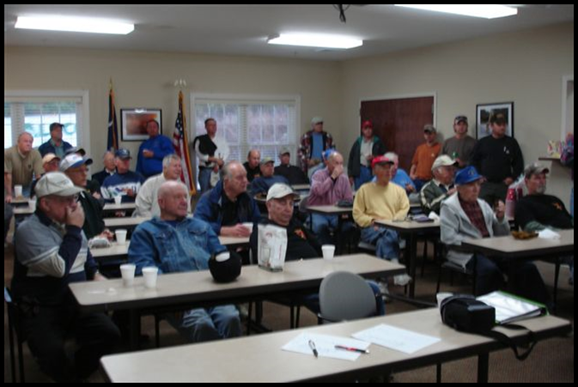
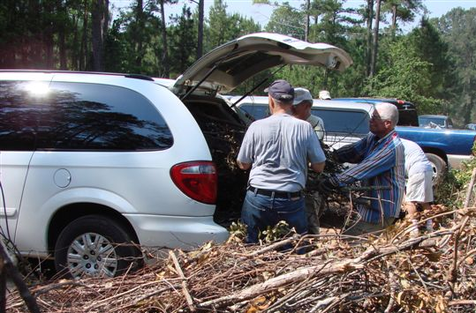
Chipping Days
Community Effort
Volunteers
Remove yard debris
Safer community
Greater appearance
Reduced wildfire risk
Keowee Key, South Carolina
Notes:
<number>
“Chipping Days”: The second action step (after the educational efforts to increase wildfire awareness) was to organize a community wide effort to dispose of the yard “fuel” residents wanted to remove from their property. Keowee Key had and still has a very effective Operations Dept. that maintains common areas in the community. They had an old chipper plus a designated yard where brush, limbs, trees etc. could be chipped.
This capability led to the first official “Chipping Day” where residents could bring their own debris to the chipping site for disposal by the Operations staff. Firewise Committee promotion of this day was very successful as a continual stream of vehicles of all types brought car trunk loads, truck bed loads and bags of yard debris to be chipped on the first official “Chipping Day”.
The Firewise effort was off and running. Residents not only felt safer about ridding their yard of potential fire danger, but they liked the improved appearance of their yards as well.
Resident volunteers were ample, consisting of Committee members and other motivated residents. The Community Operations personnel, plus our own volunteer Firemen, all pitched in to support this first launch. SCFC personnel came up to witness this effort, take pictures and offer suggestions for improved actions

Slide 13
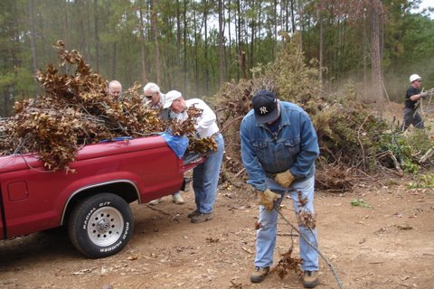
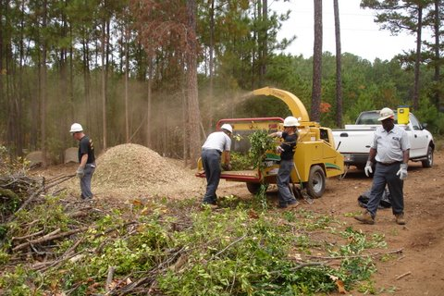
Chipping Dayscon’t
Single event in 2006
Now four events/year
Two pick up
TwoU-hauldays
Over 60 volunteers
150 residents
270 truck loads
Keowee Key, South Carolina
Notes:
<number>
Growth of “Chipping Days”: Follow through Actions
Nothing builds success so much as success itself. Keowee Key became the second Firewise Community in S. Carolina in 2006 and one of the first 150 in the Country. Chipping Days are now a four time per year event.
After several events were held, we learned that substantially greater participation could be achieved if the Committee could pick up resident yard “fuel” at the end of home owner’s driveway, rather than expecting folks to transport the debris themselves. Both resident age and vehicle profile made personal transportation a self limiting factor.
This led to two annual events dubbed “End of Driveway Pick Up” and two annual events dubbed “U Haul Days”. Resident pick up truck owners were enlisted to volunteer their time and trucks to pick up resident loads throughout the community during the End of Driveway Pick Up days.
The Firewise Committee promoted each event via internal community communication methods, bulletin boards, our local Keowee Key cable channel, web site, monthly newspaper articles and word of mouth.
From the initial humble beginning in 2006, when approximately 70 residents brought their own vehicle loads to the chipping site, our largest events now involve 18 pick up trucks, nearly 60 resident volunteers, 150 residents clearing their yards and bringing the slash to the head of their driveway, resulting in 270 truck loads from within the community being brought to the community chipping site to be chipped.

Slide 14
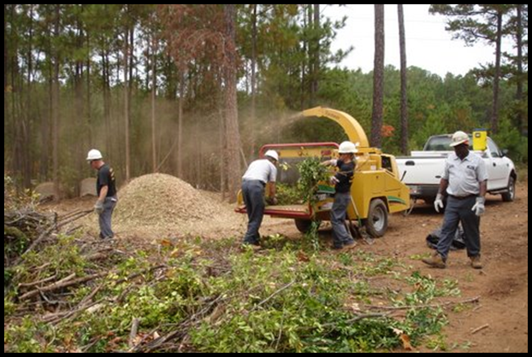
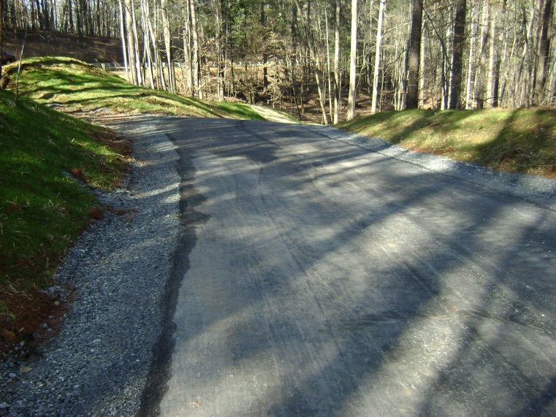
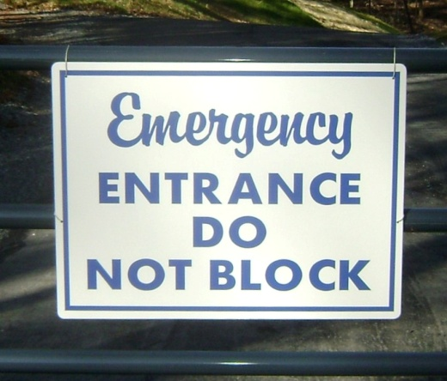
Financial Support
SC Forestry Commission grants National Fire Plan
New chipper
Underbrushingundeveloped lots
Installation of emergency exits
Keowee Key, South Carolina
Notes:
<number>
MIKE – the financial support provided through the S. Carolina Forestry Commission and the USDA FS has proved beneficial in helping to implement the communities Firewise mitigation plan Examples of this financial l support can be seen in the following projects implemented by Keowee Key.
First A new Chipper: As the “Chipping Day” events became so popular with increased community involvement, the community owned chipper became over whelmed. A 50/50 grant request to the SCFC for $10,000, was approved for a new chipper in 2007. This machine improved the community’s operations efficiency and is still running strong 6 years later.
The second major project deals with fuels mitigation on undeveloped woodland lots remediation examples:
Over 125 unimproved woodland lots are owned by the Community and this is a large challenge to get them to Firewise standards. The Firewise Committee decided to apply for a SCFC grant to underbrush three lots to demonstrate to residents as to what they could do with their own lots. A $5,000 was granted in 2008 for this effort and now the 1250 individual residents now can plainly see what action they need to take to bring their own lots to Firewise standards and improve the aesthetics and increase the property values within the community.
The third main project involves Emergency exits:
Due to the hilly topography of the community, 32 miles of private roads, the limited number of access gates and the extensive woodlands, the danger of a ground fire blocking one or more of the four exits from the community was and is a major concern. To address this issue, the Firewise Committee analyzed potential emergency exits that could be established at three critical points. One of these sites required substantial road construction and tree removal. A grant request to the SCFC for $25,000, another 50/50 grant to fund a new emergency exit was submitted and approved in 2007. This grant also included new road side signage directing emergency exit routes throughout the community.

Slide 15
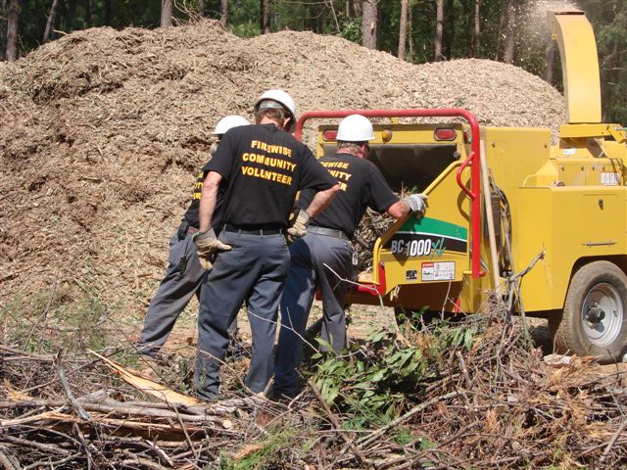
6 Major Projects $110,000+ since 2007
Chipping machine
Demo lots –underbrushing
Emergency exit
Landscaping/ renovating community grounds and building
Leaf collection recycling site & equipment
Keowee Key, South Carolina
Notes:
<number>
MIKE –
This community has become a model for other communities on how grant funds can be used to help implement the Firewise recommendations within the plan. The Firewise committee analyzes the recommendations and prioritizes them. Over the last 6 years the previous projects identified (chipper, underbrushing and emergency exit) were accomplished along with
Renovating the Community Clubhouse and Activity Center not only changing the landscaping but also the structural foundation; grant awarded in the amount of $11,800
A new leaf collecting, mulching/blowing machine and creation of the leaf recycling Site and a grant for $45,000
And new leaf collection equipment for community street side pick up in the amount of $8,200
For a total of $110,000 since 2007.
PROJECTS RECEIVING SCFC GRANTS- Matched with volunteer hours
1. Chipping machine for brush consolidation and mulch generation $10,000
2. Demonstration lot clean up examples $5,000
3. Emergency exit program and major new exit $25,000
4 TOTAL (over last 6 years ) $110,000

Slide 16
Phase Two: Sustaining the Program
Follow-up on Action Programs
Educational forums
National conferences
Awareness programs
Local meetings
Additional Fuel Reduction Programs
Keowee Key, South Carolina
Notes:
<number>
Mike –After the creating and building a Firewise program , Phase Two deals with Sustaining the Community Firewise program by providing financialincentivesto increasemotivationfor community and individualaction. Again incentives that help provide motivation that leads to action.
To achieve this sustainability in an ever evolving program one must keep informed of the changes and progress the Firewise program has made. This can be accomplished by attending national conferences and regional workshops where the sharing of other communities’ success stories can prove quite beneficial in sustaining a community's Firewise program.
Seeing this benefit the SC Forestry Commission sent Keowee Fire District personnel to the Backyards and Beyond Conference two years ago. They came back with information on an additional Firewise fuel reduction initiative, that could be implemented locally and supported by the National Firewise organization - a Leaf Collection, Disposal Program. This resulted in Keowee Key’s second major resident Firewise initiative, reducing the fire danger of uncollected leaves and was launched in Nov. 2011. This program is a perfect compliment to the “Chipping Day” events held by Keowee Key.
Leaf collection and removal is a major issue for both individual home owners and the Community’s Operations personnel. A major effort by the Operations personnel and the participation by the home owners has led to a successful fuels reduction campaign as Fall leaves are collected, recycled and reused throughout the community.

Slide 17
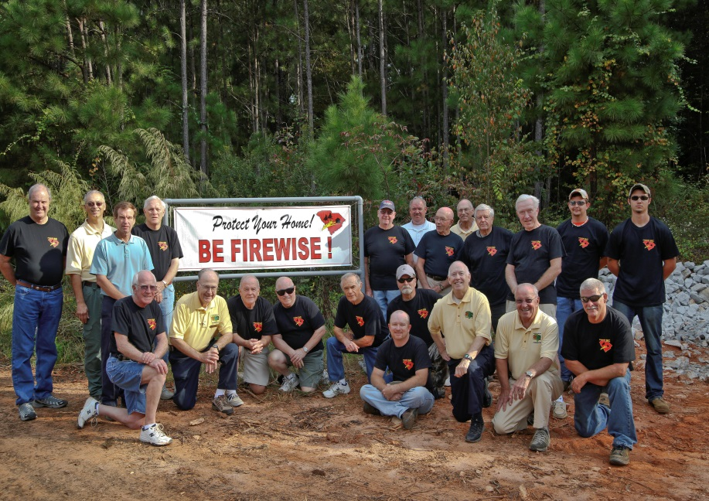
Financial Incentive -Motivation
Residents earn credits for community
Involvement leads to sense of accomplishment
Result in wide spread community involvement
Keowee Key, South Carolina
Notes:
<number>
MIKE - The fundamental concept learned at the national conference, was that financial incentives potentially available to any Firewise community can help organize and motivate residents to participate in Firewise projects such as the leaf collection and removal project.
Residents can earn an hourly rate of $21.36, the National Volunteer rate, for each hour of work reported for collecting leaves. This earned “dollar credit” goes towards a future grant submittal for Firewise improvements to collect, mulch and disperse processed leaves within the community.

Slide 18
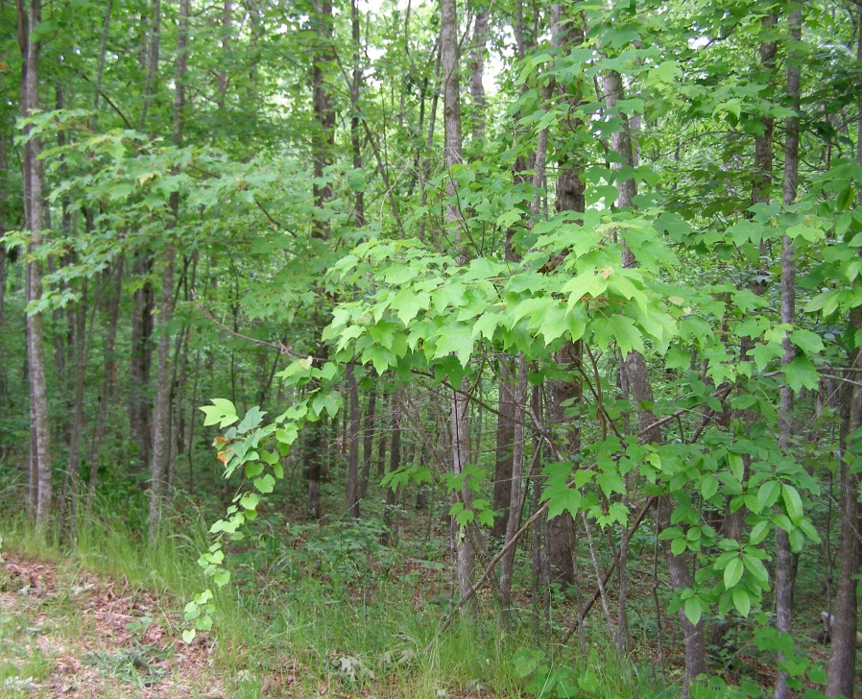
New Initiative for residents
Leaves collected by residents – hours documented
Hours turned into credit dollars (matching in-kind funds)
Used to apply for grant funds
Keowee Key, South Carolina
Notes:
<number>
ACTION AND IMPLEMENTATION:
The Keowee Key Firewise Committee, took the existing national Firewise Activities Matching Funds Recording Sheet, and made it available on line or in hard copy to our residents and Operations personnel. A vigorous promotional campaign was launched in early November, 2011, promoting the “earning potential” each resident could contribute by their efforts.
The response was frankly outstanding. Within the first three months, residents, via their personal efforts or via the hours they paid contractors, plus the hours worked by the Community Operations Dept., earned “credit” totaled over $67,000. Our residents were excited and highly motivated by this financial incentive. We learned that this personal incentive was extremely key to the success of the Program. People could contribute more than just collecting and disposing their leaves. Completing the Matching Funds form was not a chore, but a key mark of participation for each resident involved. Over 150 residents participated in three months.

Slide 19
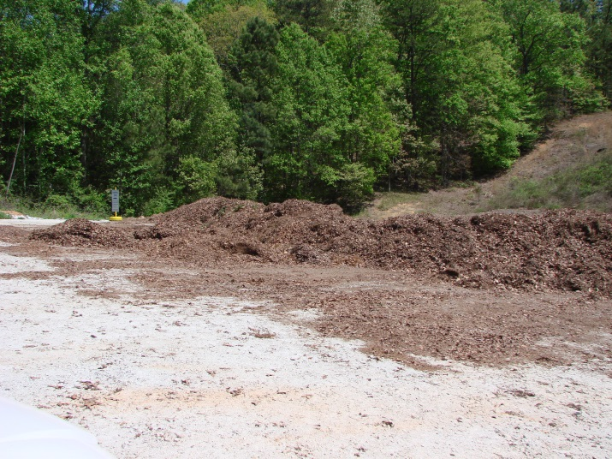
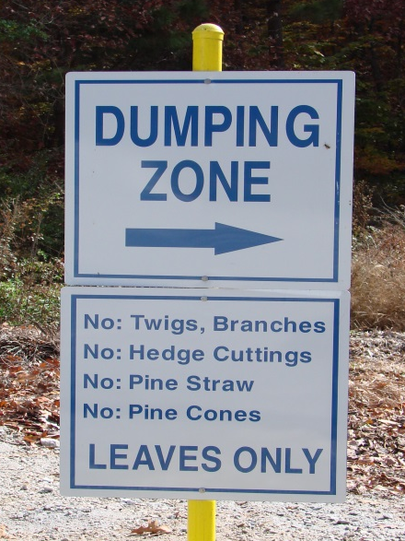
Action and Implementation
Before:Disposal site unusable
Inaccessible when wet
Leaves rotted
After:Disposal site renovated
Grant funds allocated
Access improved
Leaves recycled
Keowee Key, South Carolina
Notes:
<number>
A new leaf collection, processing, dispersal site:
These earnings enabled Keowee Key to apply for a SCFC grant to update, improve, expand and equip the existing leaf dump on site. The access road was a modest, rough, dirt lane. The drop off area was no better, plus it collected rain water which mixed with deposited leaves, leaving a smelly, difficult to manage problem.
Leaves dropped off by residents were left in storage piles to decompose as best nature could manage.
Keowee Key developed a two year SCFC grant request for $45,000 to first remediate the entrance road to a level, gravel path, expand the drop off site with drainage ditches, a smooth gravel surface, designated drop off areas, then secondly, purchase of a leaf vacuum/blower/mulcher machine and a storage area for the mulched leaves. These mulched leaves could then be spread throughout the community, thus returning the nutrients back to the soil.
The old leaf dump became transformed into a Leaf Recycling/Mulching Center when the grant funds were fully invested. The improved access road and drop off site encouraged residents to use the site even more than in the past. Rain water run off at the site is no longer a problem and the mulched leaves now have a valuable use.

Slide 20
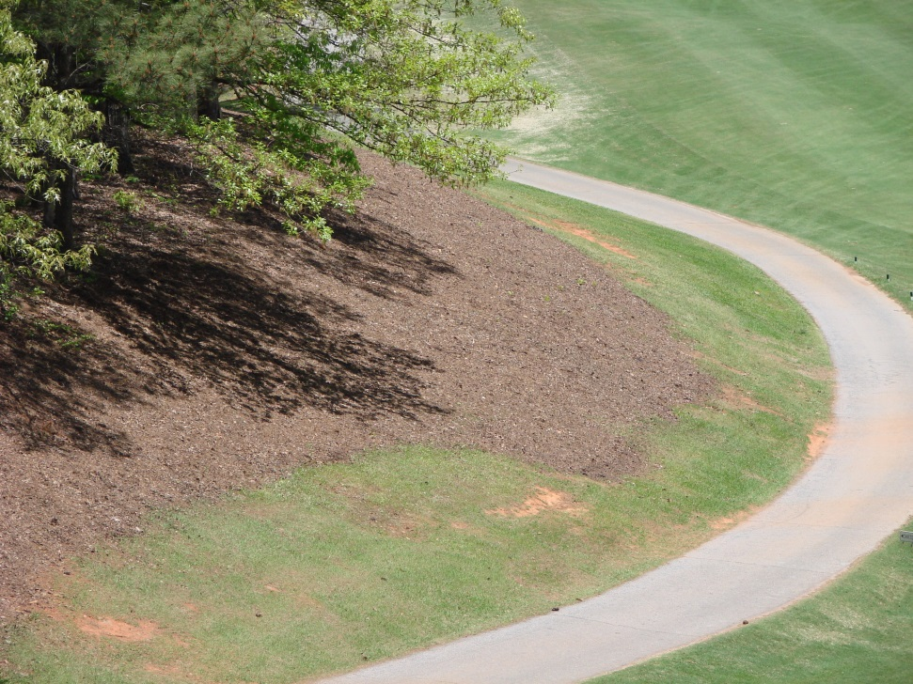
Community Benefits
Leaves recycled - used in community
Mulch on common grounds
Mulch on community golf course
Mulched leaves used
on golf course
Keowee Key, South Carolina
Notes:
<number>

Slide 21
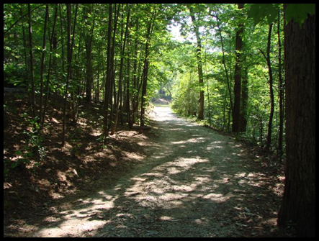
Follow Through – Ongoing Efforts
Challenges Remain
Too many residents unaware of danger
Solutions/ remediation actions not fully recognized
Additional programs identified/ not funded
Ongoing grant funding becoming scarce
Keowee Key, South Carolina
Notes:
<number>
FOLLOW THROUGH:
Challenges still remain for our community. Too many residents still are not aware of the danger of wildfire here. Required actions to improve total community preparedness are still not widely recognized. Additional programs to address fire safety and preparedness have been identified but the required funding to implement them is still to be developed. We’ve come a long way in becoming Firewise since 2004, but we can’t stop now.

Slide 22
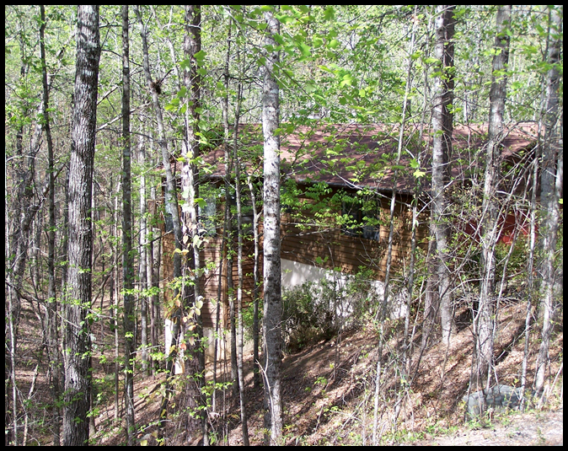
Additional Future Projects
Underbrushingundeveloped and vacant lots – fuels mitigation
Tree and limb overhangs
Emergency vehicle access – safety
Keowee Key, South Carolina
Notes:
<number>
IDENTIFYING ADDITIONAL MEANINGFUL PROGRAMS
Analyze community problems/ fire danger issues and solutions
- Demonstration unimproved/vacant lot Firewise remediation
- Implementation of Firewise tree and shrubbery practices at Community building
Tree and limb overhang dangers – personal safety – ice/snow removal
-Emergency vehicle access improvements (new future program )
-Fire and emergency vehicle street safety program (new future program)

Slide 23
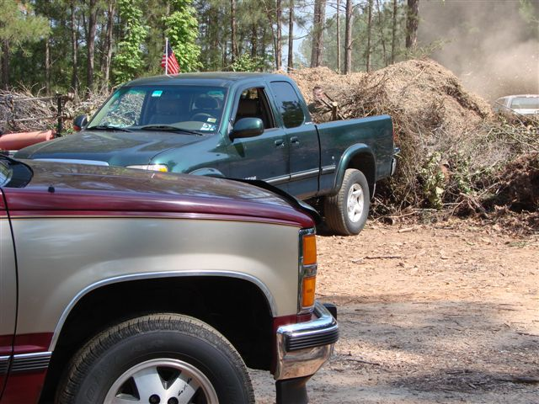
Summary – Keowee Key
Success story so far
Concerned/ Motivated individuals
Defined action programs implemented
Education/ Program support – SCFC, Keowee FD, and
NFPA resources
Proven Program
Keowee Key, South Carolina
Notes:
<number>
SUMMARY:
This story so far is obviously a successful one, that demonstrates how a concerned group of individuals can first learn about Firewise issues and dangers, educate and motivate community residents to act, take advantage of the expertise and support of local Firemen and State Forestry Commission personnel, plus National Fire Protection Association grants and then cooperatively and jointly develop a successful Firewise Community effort resulting in substantial improvement in local woodland fire safety for home owners and our community, Keowee Key.

Slide 24
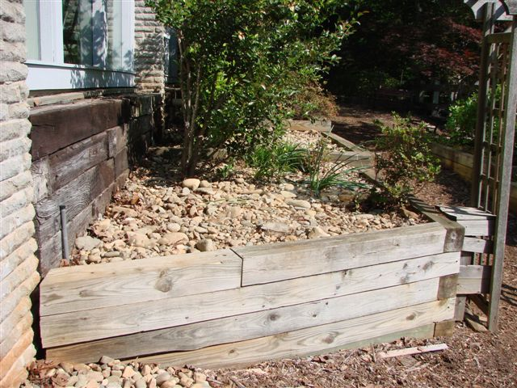
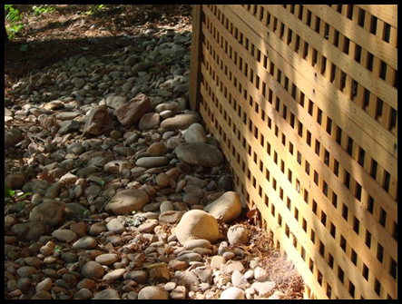
Summary – Keowee Key
Continued involvement
Educational events
Actual accomplishments
Positive results
Active participation
Reduced fire hazard
Improved aesthetics
Increased property values
Keowee Key, South Carolina
Notes:
<number>

Slide 25
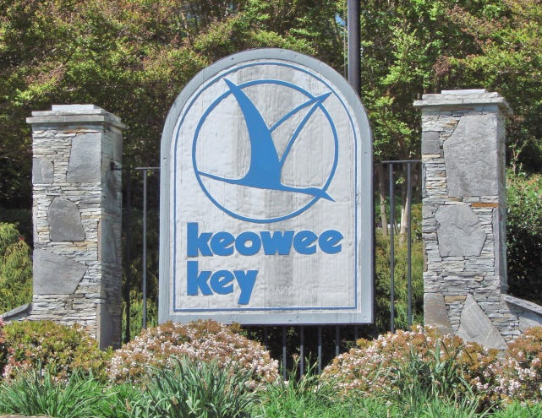
Thank You
Richard Hiss, Keowee Key Firewise®Chair
Mike Bozzo, Past Firewise®Program Manager for the South Carolina Forestry Commission
Keowee Key, South Carolina
Notes:
<number>

